Slide 1
NLTRA Updates
April 10, 2019

Slide 2
TOT Collections by Region
Notes:
177% increase in last 10 years
50% occupancy - +20% = $3.6 M per year

Slide 3
TOT Collections by Quarter

Slide 4
Growth in Q1 & Q2 2017 to 2018
$1.2 million total increase
12% growth Q1
14% growth Q2

Slide 5
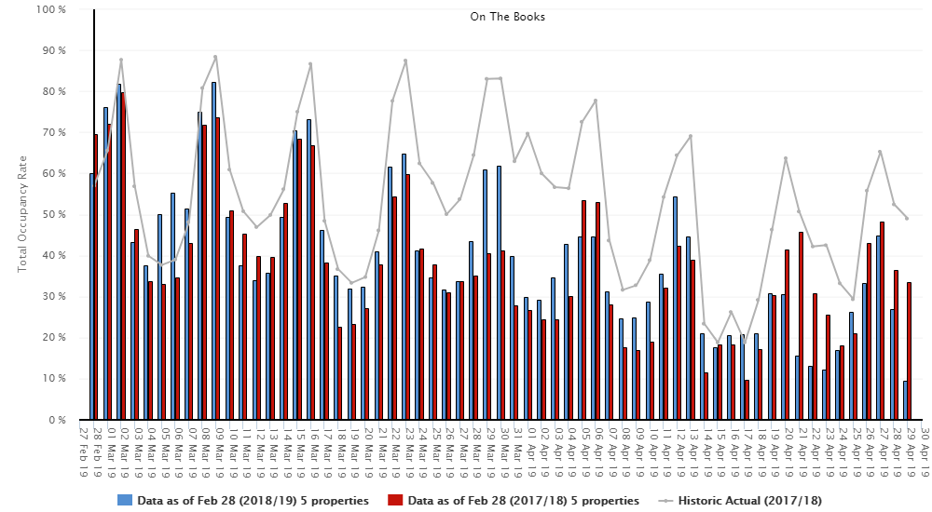
Nltra 2018-19 Priorities
Notes:
But this slide depicts are challenges
We still have very significant peaks and valleys
This is our current forecast – now until Thanksgiving = most of our properties are far below 50% occupancy for the next four weeks –
This is a very typical graph for our area that shows for about 40 weeks of the year we have significant vacancies during the mid-week and even on weekends
Our visitation is extremely volatile and creates significant challenges for businesses to provide full-time services and employment
We carefully analyze and track our upcoming bookings and continue to work to ease those deep valleys

Slide 6
Growth in Q2 & Q4

Slide 7
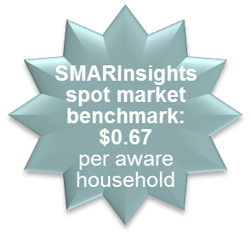
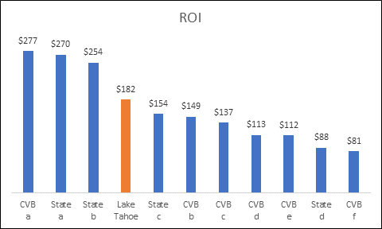




Advertising Insights - SMARI Research
Results of the 2017/18 Paid Media Advertising Campaign:
Influenced nearly $154 million in visitor spending, equating to an ROI of $182 for every $1 spent on paid media.
Reached nearly 5.3 million households in designated targeted markets at a cost of $0.16 per household. That is 4x more effective than the average DMO’s cost of $0.67 per household.
Received excellent ratings, rarely seen for local DMOs - all communication attributes received ratings over 4.0 out of a 5.0 rating system.
Visitors who were aware of the advertising campaign stayed longer, spent more, and participated in extra activities.

