Slide 1
Board Retreat 10/16/17
Presentation with Notes added.
Strategic Planning Retreat
October 16, 2017
Facilitator: Lauren O’Brien
Board members in attendance: Adam Wilson, Christy Beck, Erin Casey, David Tirman, Samir Tuma, Brett Williams
Staff in attendance: Andy Chapman, Cindy Gustafson, Ron Treabess, Lauren Sully, Sarah Winters, Anna Atwood, Jason Neary, Al Priester, Dawn Teran.
Public in attendance: Lindsay Romack, Lauren OBrien, Joy Doyle, Mike Staudenmayer

Slide 2
Agenda
Overview (History, Mission, SWOT)
Vision per the Tourism Master Plan
Closing the gap
Role of NLTRA
Committee Recommendations Review → Solidify next steps
Marketing
Chamber
Governance
Governance Structure Discussion

Slide 3
North Lake Tahoe Resort Association – Background and History
HISTORY OF TOT COLLECTIONS IN PLACER COUNTY
1965 - Transient Occupancy Tax collected in Placer County
1983 – Sometime before 1984 - 50% to General Fund to augment County services for Tourism impacts
50% to Chamber/VCB for promotions, visitor services and special cultural and sport events
1984 - Increased from 6-8% TOT Advisory Committee established by Board of Supervisors
additional 2% used for construction of conference/community-use facilities in Tahoe
1995 – North Lake Tahoe Tourism Master adopted, NLTRA formed
1996 – TOT increased from 8-10%
additional 2% used for Infrastructure development and visitor related services
2002 – Renewal of 2% for 10 years
2012 – Renewal of 2% for 10 years

Slide 4
NLTRA Mission Statement
TO PROMOTE TOURISM AND BENEFIT BUSINESS THROUGH EFFORTS THAT ENHANCE THE ECONOMIC, ENVIRONMENTAL, RECREATIONAL, AND CULTURAL CLIMATE OF THE NORTH LAKE TAHOE AREA

Slide 6
Board Feedback
Mission
SWOT
Comments

Slide 7
Mission
Achieve TMP or convene around achieving TMP
Marketing & tourism (out of area)
Economic development advocate/voice for areas
Represent business community – driving tourism to NLT
Strong Chamber role: community advocacy

Slide 8
Board SWOT
Strengths
Weaknesses
Putting dollars into marketing vs.infrastructure
No ROI on advertising – show results
Internal controls/accounting/policies
Broader geographic engagement
County relationship
Board not engaged – lack of communication
Need forward looking board w/vision
Not sharing what we are doing
No diversified funding
Weak chamber
Can’t supply service industry with workers
New Leadership (Cindy)
Conference, group, events
Connections to business community/local knowledge & voice
Knowledge on board
Good community presence
Diversity of board
Community voice – can convene & provide forum
Significant revenue stream
Marketing (not all)
Notes:
- Add under Weaknesses “Board structure”
- Add under Weaknesses “ROI method for results”

Slide 9
Board SWOT
Opportunities
Threats
New leadership/leadership role
Focus marketing on getting better flights to Reno
Attracting midweek visitor
More conference/group
More business promotion
Transportation and housing
Sponsorship, outdoor activities
Diversity funding base
Key constituents need to be on the board
Leadership to achieve TMP/transit & trails
Figure out who NLTRA is & governance
Improve relationship with County
Efficiency of board
Disengaged board – not right composition – Need Gms’ of resorts
Placer County – conflict, contract term, stuck
Squaw valley splintering TBID
Not a unified front on board
Finance/funding
Demise of NLTRA under current conditions
Too crowded – turn off
Notes:
- Add under Threats, “GM’s of Resorts should be on Board.”
- Add under Threats, Demise of NLTRA “with the County situation.”
- Threats-Too crowded – turn off, this threat is “directed from the guest perspective.”

Slide 10
Other comments
Committee Recs
In general most agree some not familiar
Chamber one – well done – should be lead org. but most at risk – no $’s
To achieve TMP – diversity of opinions
Move more marketing dollars to transportation & infrastructure
Keep marketing dollars we need them to stay competitive
Wildly underfunded – need to figure out how to raise $’s
People get disillusioned that we don’t have $’s
County can not do it alone – can’t move fast enough
Need to figure out how to close the gap (need infrastructure before more marketing)
Not very up to speed on this though vision is impt.

Slide 11
Other comments
Fundraising
In favor of TBID as a region
TOT should be 14%
Need strategy to fund gap & public support
Governance/board dynamics
Communication: Don’t feel free to speak up/respected/not enough info to engage
Prefer County not on board - need to trust, not aligned,
Number of seats:
Not more people - keep simple, like#, don’t think you can recruit more
More people better – recusals, at large, more categories
Keep DMO and Chamber boards close/not convinced about separate boards
Notes:
-Move ahead to research these items:
1. Sales Tax-Transit & Transportation
2. TBID
-Lodging, retail, restaurants and recreation.
-Need to know $ that could go to Chamber. What are the funding streams for the Chamber?
-Chamber could get Tier 2 & 3 revenue.
3. TOT (& uncollectibles)

Slide 12
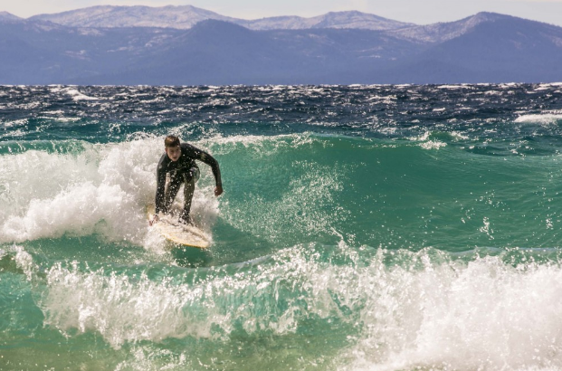
Partner Feedback
Mission
SWOT
Comments

Slide 13
Mission
Heads in beds
Tourism and PR of NLT region
Represent business and regional interests
Fulfill tourism master plan
Oversight on how TOT is spent
Notes:
The last bullet regarding the Chamber role does not align with mission, it is not consistent.

Slide 14
Partner SWOT
Weaknesses
Strengths
More holistic representation of NLT/seems bifurcated
Chamber is broader than tourism- many feel left out
Don’t stick with things long enough – mktg. strategy
Voice of small business not heard
Chamber should be lead organization – now weak
Downtown associations should have smaller boundaries –not good for chamber
County relationship
Ability to market the region
Web and social media
Promoting community needs/infrastructure
Partnership with Incline
Good DMO
Opportunities
Threats
Being a bigger broader voice for NLT
Represent all communities of NLT
Experiential marketing to differentiate from other areas (CO, UT)
Partner with business community – (Reno)
What is real vision of our community – more than tourism
Like committee recommendations
County’s misunderstanding of value of NLTRA
South Lake Tahoe – undergoing Renaissance
Outdated infrastructure
Business barriers to entry in NLT vs. other areas
Small thinking about region
Need dollars for aging infrastructure
Loss of local control and local expertise – they are leaving
Notes:
-

Slide 15
Other comments
Focus on gap to achieving TMP
NLTRA knowledge of NLT needs is stronger than County’s
Loss of local control will hurt achieving TMP
Agree with TBID
Opportunity to make Tahoe City/NL a remote working place
Think you need two boards for chamber and DMO
Need to think about community and economic development
Look at what Reno has done
Agree with committee recommendations

Slide 16
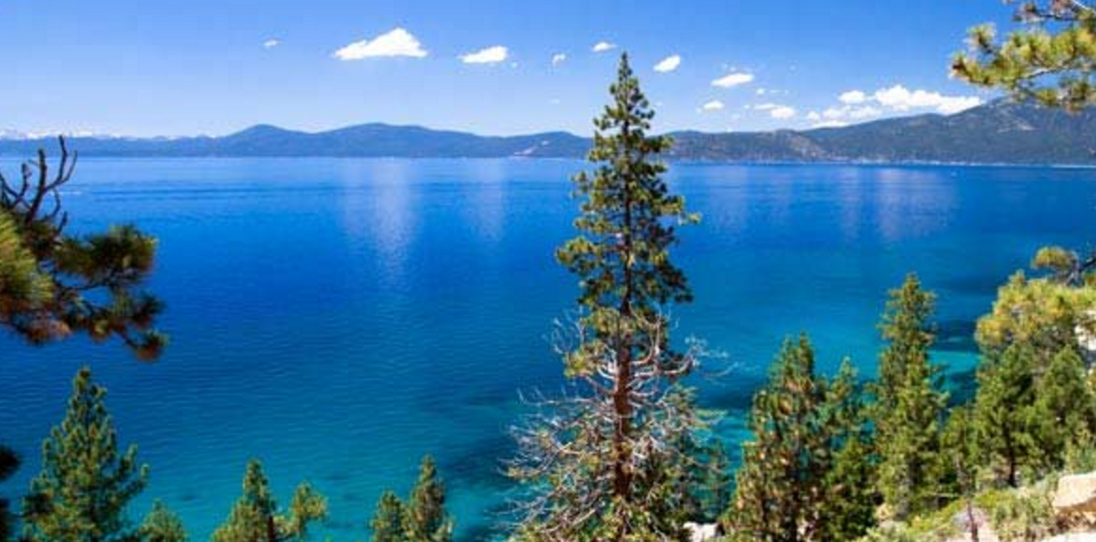
OUR REGIONAL VISION

Slide 17
Tourism Master Plan Priorities
Visitor Activities & Facilities: Tier 1 Priority
 |  |  | Annual | 8 Year Estimate
 | Provide connected trail systems throughout North Lake Tahoe including:
 |  | Class 1, Mtn Bike, Nordic trails | $ 6,456,250 | $ 51,650,000
 |  | Bicycle signage and amenities | $ 40,000 | $ 320,000
 |  | Capital replacement program for trails | $ 500,000 | $ 4,000,000
 |  | Winter use of trail systems | $ 100,000 | $ 800,000
 |  | Trails Total | $ 7,096,250 | $ 56,770,000

Slide 18
Tourism Master Plan Priorities
Transportation: Tier 1 Priority
 |  |  | Annual | 8 Year Estimate
 | Fund and implement the Transit Vision to provide frequent, fun, and free Transit Service |  | $ 3,100,000 | $ 24,800,000
Notes:
-8 Year plan.
-Strategize Tier 1 and Tier 2 Priorities.
- Placer allocating on annual basis but money might be earmarked in order to be successful and leveraging (Tier1 vs Tier 2).

Slide 19
Tourism Master Plan Priorities
Marketing and Visitor Information: Tier 1 Priority
 |  | Annual | 8 Year Estimate
 | Increase domestic and international destination visitors traveling from longer distances | $ 1,900,000 | $ 15,200,000
 | Implement user-friendly visitor guide technology, accessible on a variety of devices | $ 300,000 | $ 2,400,000
 | Marketing/Visitor Information TOTAL | $ 2,200,000 | $ 17,600,000
Notes:
- These totals are in addition to the current budget.

Slide 20
Tourism Master Plan Priorities
Tier 1 Priorities - Summary
 |  | Annual | 8 Year Estimate
 | Visitor Activities & Facilities | $ 7,096,250 | $ 56,770,000
 | Transit | $ 3,100,000 | $ 24,800,000
 | Marketing/Visitor Information | $ 2,200,000 | $ 17,600,000
 | TOTAL Additional Funding Needed | $ 12,396,250 | $ 99,170,000
Notes:
- 4.4 mil is actual total including fund balance remaining from last year.
- 45,000 existing, not including, the current 2% TOT coming in (non-collected.)
- Raise money for Civitas research.
- Under Funding Strategies, should be ½ cent sales tax. Trails, transit and transportation.
- Call group (Stacey, JT, Alex, Jim) back together and invite to November meeting.

Slide 21
TOT Leverage of Capital Investment
1996-2016
$ 34,912,431 TOT investment in Infrastructure
$ 206,794,114 Matching Funds from Other Sources
$ 241,706,545 Total Expended
TOT represents 14% of Total Investment made in since 1996

Slide 22
Tourism Master Plan Priorities
Tier 1 Priorities
 |  | Annual | 8 Year Estimate
 | TOTAL Additional Funding Needed | $ 12,396,250 | $ 99,170,000
Funding Strategies
 | ½ % Sales Tax | $ 1,500,000 | $ 12,000,000
 | 2 % TOT/Lodging TBID | $ 3,200,000 | $ 25,600,000
 | County TOT (uncollectibles) | $ 5,000,000 | $ 40,000,000
 | Total Funding Strategies | $ 9,700,000 | $ 77,600,000
 | Gap (or required leverage) | $ (2,696,250) | $ (21,570,000)

Slide 23
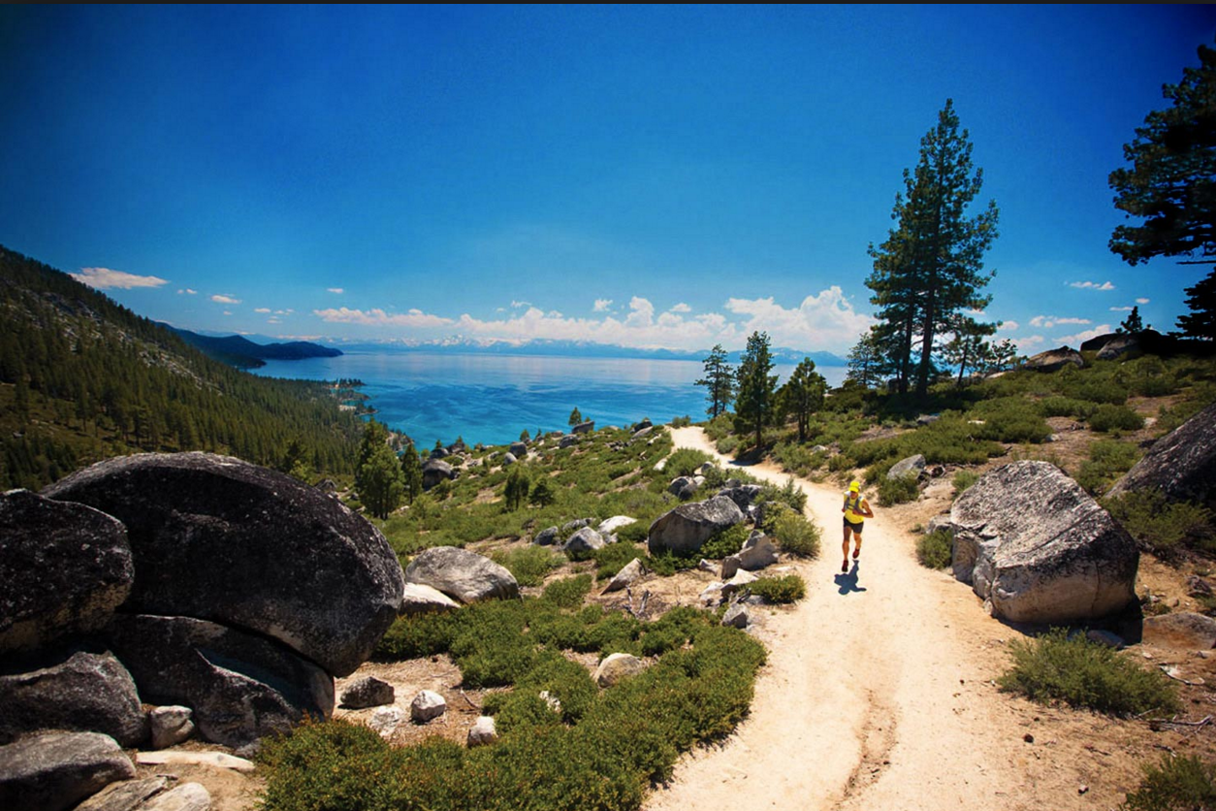
WHAT IS THE ROLE OF NLTRA IN ACHIEVING THIS VISION?
HOW DO WE CLOSE THE GAP TOGETHER?

Slide 24
Current Organizational Structure
Members
11 voting seats – voted by members
1 ex-officiio (TRPA)
Set Bylaws
Oversight/Strat. Direction
Business must be in Placer County
Board
County
Trans. & Infrastructure
Chamber
Visitor Bureau
Advisory – Transp.
Co-chair- Infrastructure
Community engagement
Advocate for visitor amenities
Events
Collaboration of Chambers
Large geography promotion
Destination Marketing
Sales
Events
Visitor Information
Notes:
*See additional page at end of presentation

Slide 25
Organizational Task Force Recommendations
Marketing | Recommendations |  |  |  |  |  |  |  |  | Responsible Party
 | Define strategy and role for the DMO |  |  |  |  |  |  |  |  | Board & major stakeholders
 | Include strategy for collaboration |  |  |  |  |  |  |  |  | Board & major stakeholders
 | Evaluate the DMO spend compared with other similar destinations |  |  |  |  |  |  |  |  | Staff
 | Strengthen DMO role to be more competitive
 |  | Identify dollars needed to do the job |  |  |  |  |  |  |  | Board /Staff
 |  | Strategic focus on expanding alternative resources for long-term vision |  |  |  |  |  |  |  | Board /Staff
 | Consider TBID and/or TOT to raise additional funds |  |  |  |  |  |  |  |  | Board
 | Expand sponsorships and grants to raise funds |  |  |  |  |  |  |  |  | Staff

Slide 26
Organizational Task Force Recommendations
Chamber | Recommendations |  |  |  |  |  |  |  |  | Responsible Party
 | Strong regional Chamber is needed to represent and serve the broader business community |  |  |  |  |  |  |  |  | Board
 | Funding should be driven by membership, sponsorships and some public funding, creating a diversified sustainable revenue base |  |  |  |  |  |  |  |  | Board/Staff
 | Deliverables derived from this process, including the "Programmatic Priorities" should inform a broader strategic plan and next steps |  |  |  |  |  |  |  |  | See below
 | The deliverables need to be further explored |  |  |  |  |  |  |  |  | Chamber Committee
 |  | Economic Development - assist with permits |  |  |  |  |  |  |  | TBD
 |  | Community Development - Housing |  |  |  |  |  |  |  | Board/Staff - Underway
 |  | Workforce Development - Recruitment & Retention |  |  |  |  |  |  |  | Staff
 |  | Legislative Advocacy - State and Local |  |  |  |  |  |  |  | Board/Staff
 | Collaboration is key to a strong chamber, before expanding areas of service |  |  |  |  |  |  |  |  | Chamber Committee – Underway
 | Check in at least annually to ensure progress to the strategic plan |  |  |  |  |  |  |  |  | Chamber Committee
 | Follow the Draft Conceptual Shared Guiding Principles developed by Committee |  |  |  |  |  |  |  |  | Chamber Committee - Underway

Slide 27
ROLE OF CHAMBER
Helping businesses prosper& helping our communities thrive
Catalyst, convener, champion
Depth of Knowledge
Unimpeachable Trust
Universal Respect
Advocate for Business
Pillar of the Community

Slide 28
Organizational Task Force Recommendations
Board Governance | Recommendations |  |  |  |  |  |  |  |  | Responsible Party
 | Broaden representation of stakeholders to provide vision and direction to staff and committees, maximizing flexibility for inclusion of diverse industry sectors and geographic areas.
 |  | Determine County staff's role on Board |  |  |  |  |  |  |  | Board/County
 |  | Consider size of Board 15-20 |  |  |  |  |  |  |  | Board
 |  | Move meetings throughout area |  |  |  |  |  |  |  | Staff - Underway
 |  | Consider live-streaming of meetings |  |  |  |  |  |  |  | Staff
 |  | Provide a larger number of At-Large seats providing diversity of industries |  |  |  |  |  |  |  | Board
 |  | Provide greater public access of files on website |  |  |  |  |  |  |  | Staff
 |  | Reconsider the current term limits, may be harming the organization |  |  |  |  |  |  |  | Board
 |  | Increase succession planning for board members |  |  |  |  |  |  |  | Board & Staff

Slide 29
Organizational Task Force Recommendations
Board Governance | Recommendations |  |  |  |  |  |  |  |  | Responsible Party
 | Broaden representation of stakeholders to advise staff and board on execution of strategic goals and mission, through specific expertise, geographic diversity, and industry perspective as appropriate.
 |  | Establish a Chamber Committee |  |  |  |  |  |  |  | Board
 |  | Move meetings throughout area |  |  |  |  |  |  |  | Staff - Underway
 |  | Actively manage potential conflicts of interest rather than restricting membership |  |  |  |  |  |  |  | Board & Staff Underway
 |  | Broader notification of committee meetings and agendas |  |  |  |  |  |  |  | Staff
 | Provide an accessible, easy to understand framework of rules to govern operations and adequate information to assist with decisions that impact the organization and the community.
 |  | Subcommittee of Board to work on full review of bylaws/supplemental operating procedures |  |  |  |  |  |  |  | Board/Staff/ Legal
 |  | Simplifying Placer County Contract - extending length |  |  |  |  |  |  |  | Board/Staff/County
 |  | Employee handbook - to update new HR laws in California |  |  |  |  |  |  |  | Staff/Consultant

Slide 30
Governance
Suggestion
13-15 Voting Members + 1-2 Ex Officio
Combination of Designated Seats
Elected Seats and
Appointed Seats
Ensuring geographic diversity, representation of key industries,
Representation of TOT collections,
as well as providing opportunity for other business types.
Current
11 Voting Members + 1 Ex Officio
Elected Seats:
Large Lodging
Small Lodging
Real Estate/Property Management
Restaurant
Retail
Recreation
Ski Area
General
At Large
Appointed Seats:
Board of Supervisors Appointment
County CEO Appointee
Notes:
*See additional page at end of presentation.

Slide 31
END
Chart to right was created by Lauren Obrien regarding funding and added from notes taken at the presentation to the Board on 10/16/17:

Slide 32
END
*This slide is comprised of notes taken at the presentation to Board on 10/16/17
Next Steps: Governance
- What is the role of Ex-Officio?
- What is the role of County?
- Consider Chamber role.
- DMO and relationship with Chamber needs to be addressed.
- Look into composition with Chamber.
- Bylaw and governance changes with timing and term limits, work with Executive Committee-December Board meeting.
--Agendize Chamber Subcommittee work and direction to adapt to outcome (1 hour).
-Invite Subcommittee members and Cindy to meet with the subcommittee beforehand.
-Subcommittees need to be defined to figure out Board Structure.
-Figure out barriers to small business participation.

Slide 33
Governance Actions
November agenda: proposal of new structure
Possible postponement of election? Non peak time.
Bylaw and governance changes with timing and term limits,
Work with Executive Committee to prep for formalizing at December Board meeting.
Agendize Chamber Subcommittee work and direction to adapt to outcome (1 hour).
Invite Subcommittee members and Cindy to meet with the subcommittee beforehand.
If Executive Board can review draft (of new governance structure) it can be ready for November meeting.

Slide 34
Governance – additional questions to answer
What is the role of Ex-Officio?
What is the role of County?
Consider Chamber role.
DMO and relationship with Chamber needs to be addressed.
Look into composition with Chamber.
Subcommittees need to be defined to figure out Board Structure.
Figure out barriers to small business participation.

Slide 35
END
*This slide is comprised of notes taken at the presentation to Board on 10/16/17
Board Structure notes
-Staff’s suggested seat list:
6 Designated (Sugar Bowl, Squaw, Northstar, Ritz, Homewood, RSC) -3 Property Mgmt (1 TC/West Shore, 1 CB/KB, 1 at Large), 2 elected at large seats, 3 appointed at large seats, 1 Board of Supervisors
Comments:
Small Restaurant, retail? Consider Chamber role.
Term Limits 6 seats stay. 12 year term limits. At large, shorter?
Look at type of seat.
Timing? Non-Peak time. March retreat. February election?
Potential to have more seats on Chamber.
What about Business Districts on Board?
Funding constraints for Chamber?

Slide 36
End notes
*This slide is comprised of notes taken at the presentation to Board on 10/16/17
Create a better onboarding process (orientation) for new Board members.
Bring new Board members on in March and retreat in April.

Slide 37
BACKUP Tourism Improvement Districts
100 in State of California
Ranging from 1% to 4.5% on Lodging
Retail, Restaurant, Attractions: Ski, bike, boat, kayak

