Slide 1
NORTH TAHOE COMMUNITY SERVICES DISTRICT

Slide 2
Community Services Districts
Community Services Districts are a form of independent local government used to provide services in unincorporated areas of a county.
Examples near us include:
Northstar Community Services District
Incline Village General Improvement District
Squaw Valley Public Services District
There are currently more than 300 CSDs in California
CSDs throughout California are heralded as model government for smaller communities.

Slide 3
Community Services Districts
A Community Service District CAN:
Provide A Variety of Services
Water
Sewer
Recreation Facilities and Programs
Garbage Collection
Fire Protection
Street Lighting
And Facilities and Services that Promote the Public Peace, Health, Safety, and Welfare

Slide 4
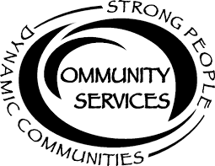
Community Services Districts
Community Services Districts May Also Be:
An effective form of governance for combining two or more special districts that serve overlapping or adjacent territory into a multifunction special district.

Slide 5
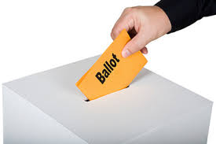
Community Services Districts
A Community Service District Cannot:
Make Land Use decisions
Unilaterally Increase Taxes
Be Formed without Consent of the Voters of the current Special Districts

Slide 6
Community Services Districts Benefits

Slide 7
Benefits
Potential Benefits Include:
Ability to Enhance Services
Consolidation of Resources - Three into One Strong Agency
United Voice for our Community
Governance embracing the North Shore as One Region
Consolidate and Strengthen Management Positions

Slide 8
Benefits
Potential Benefits Include:
Consolidated IT systems (SCADA, GIS, Asset Management, Accounting)
More Flexible Use of Assets (backhoes, Vactor trucks, GPS equipment, etc.)
One Parks/Recreation program for the area
One Water/Sewer/Fire Service for the area
Combining Water and Fire Services will enhance public safety -- with a single planning, investment, operations, and coordinated delivery process

Slide 9
Fiscal Impacts
Fiscal Efficiencies Benefit Community
Administrative
Organizational
Boards of Directors
We do!

Slide 10
Operational Impacts
Operational Benefits to Community?
Fiscal (economies of scale)
Service delivery
System Integrity
Safety

Slide 11
Governance Impacts
Enhanced Local Governance Benefits:
Decisions Made Locally
Leverage
Political influence with County and other agencies
Access to capital
Strategic planning
Policy-making

Slide 12
Let’s consider
FIRE
Greatest threat to North Shore
2015 - 9 million acres burned in California
Are we prepared as a community?
Have we devoted enough resources?

Slide 13
Next steps. . .

Slide 14
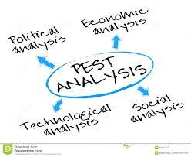
It’s Time to Learn More. . .
An Analysis will help Decide if it’s a Good Idea to Consolidate Agencies
Study existing conditions
Plan alternative futures
The More We Know!

Slide 15
Community Process
The Boards of the Special Districts Agree to Fund an Analysis of Potential Benefits to the Community.
Finances
Operations
And Governance
Determine possible LAFCo procedures moving forward
NTPUD
TCPUD
NTFPD

Slide 16
Community Process
A CSD Formation Review Committee
Appointed representatives from the three Special Districts
Citizens/Rate Payers of the Districts
As Community Members and Rate Payers, We Can
Support an objective analysis of the potential benefits and/or limitations of forming a Community Services District
Ask your local deciders to support the analysis
Sign up to be part of the review committee
Tell you friends and neighbors
NorthTahoeCSD@gmail.com

Slide 17
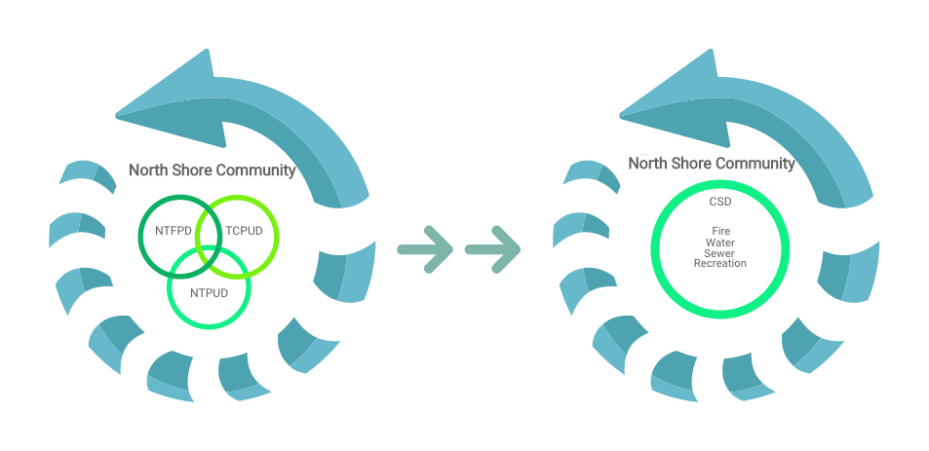
A Final Thought
If we open a quarrel between past and present, we shall find that we have lost the future.
Winston Churchill
Questions/Comments:
NorthTahoeCSD@gmail.com

Slide 18
Discussion

