Slide 1
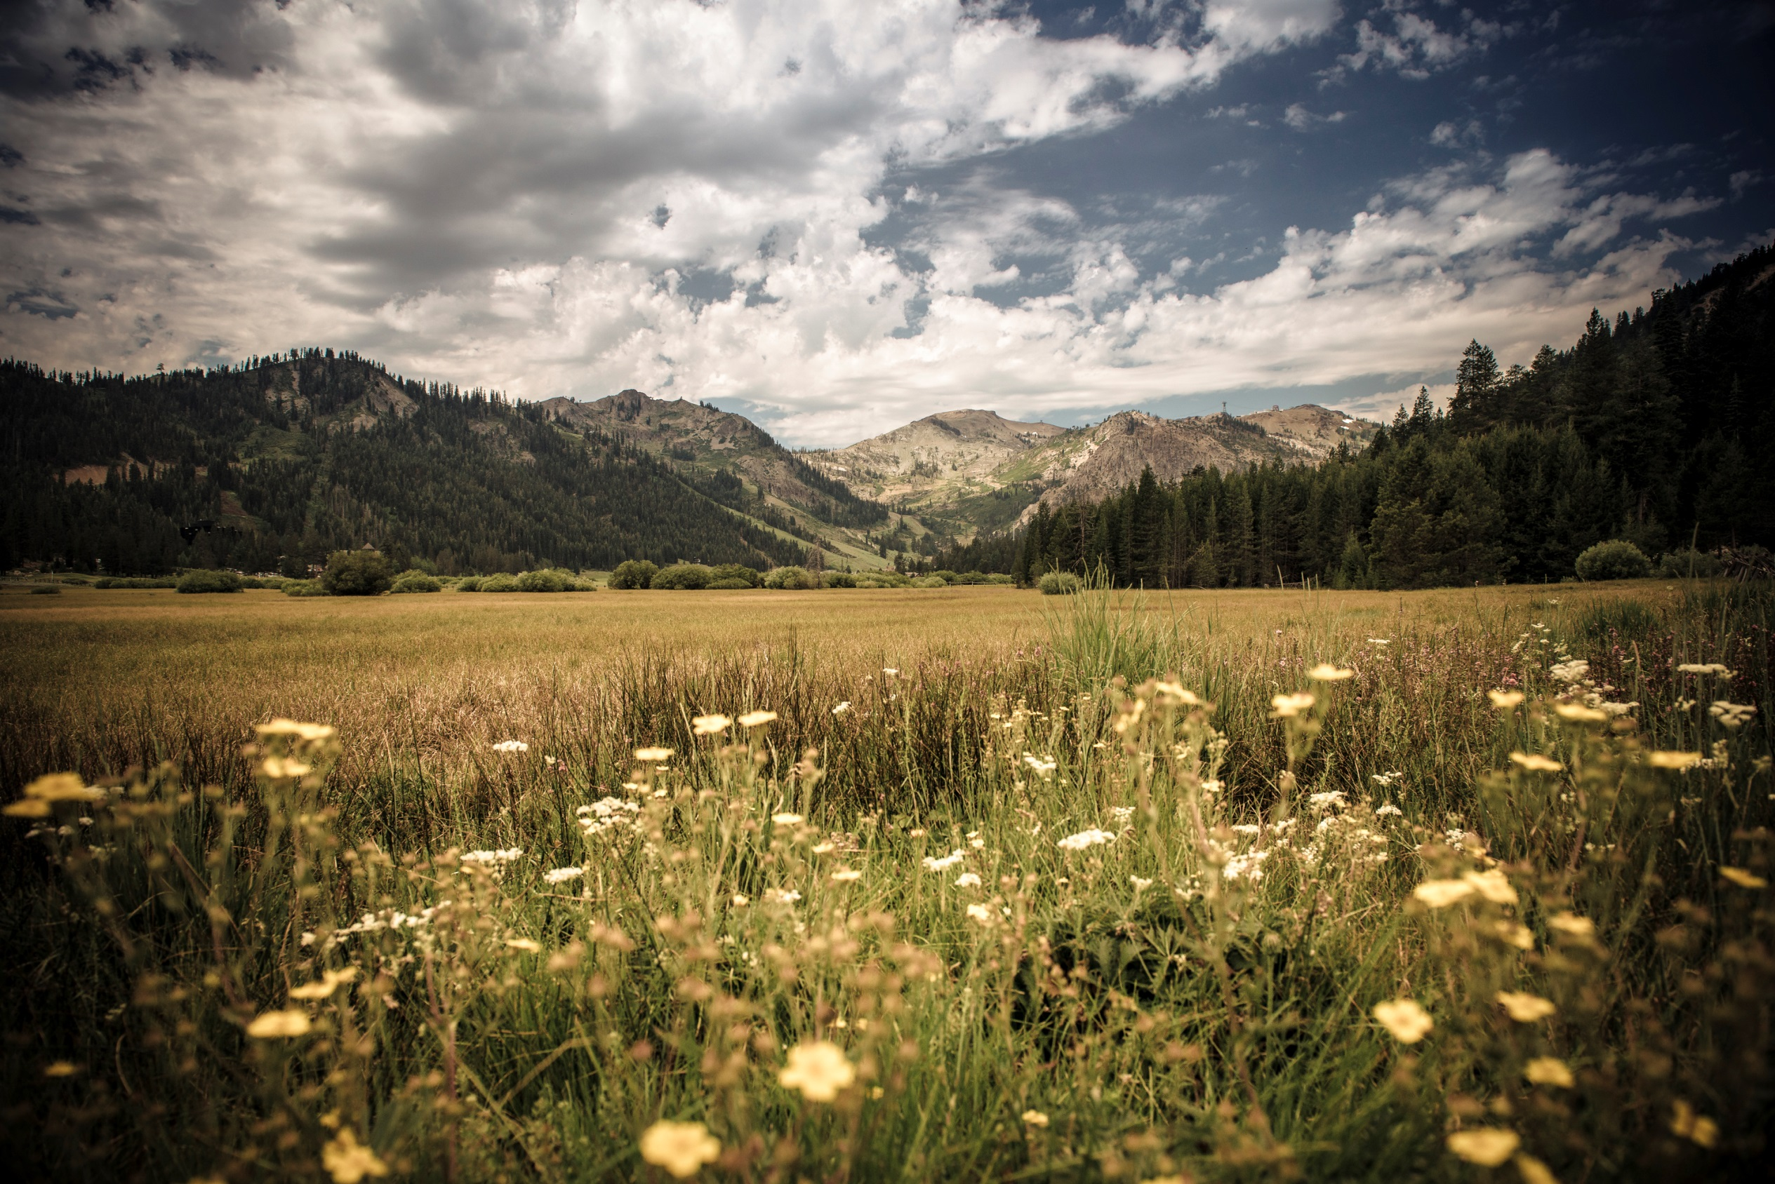
The Village at Squaw Valley
North Lake Tahoe Resort Association Board Meeting
April 5, 2016

Slide 2
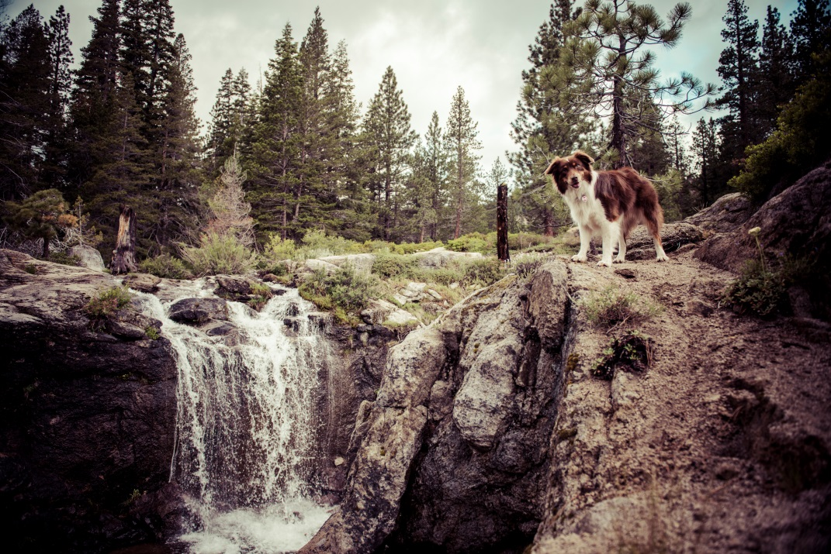
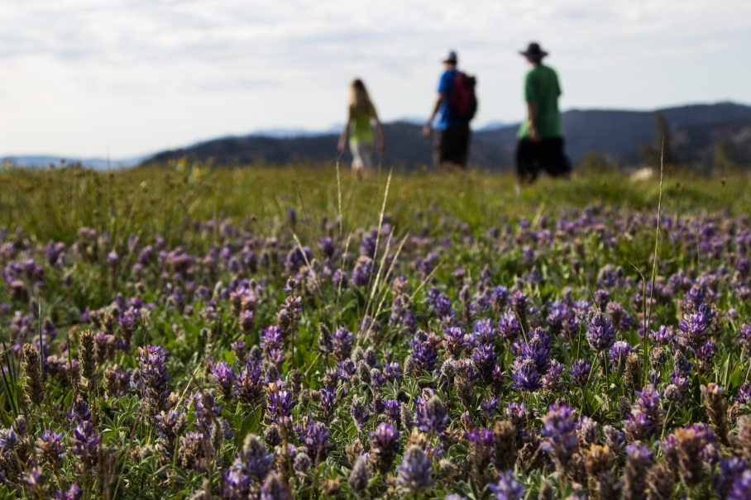
Evolution and Benefits
Plan Changes/Downsizing
Community Benefits
Plan Economics
Environmental Benefits

Slide 3
Community Informed
Village Changes

Slide 4
Reduced Lodging Units

Slide 5
Reduced Bedroom Counts

Slide 6
Reduced Workforce

Slide 7
Community
Benefits

Slide 8
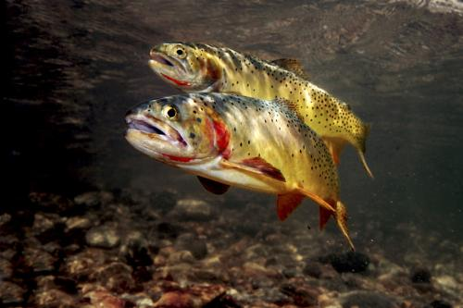
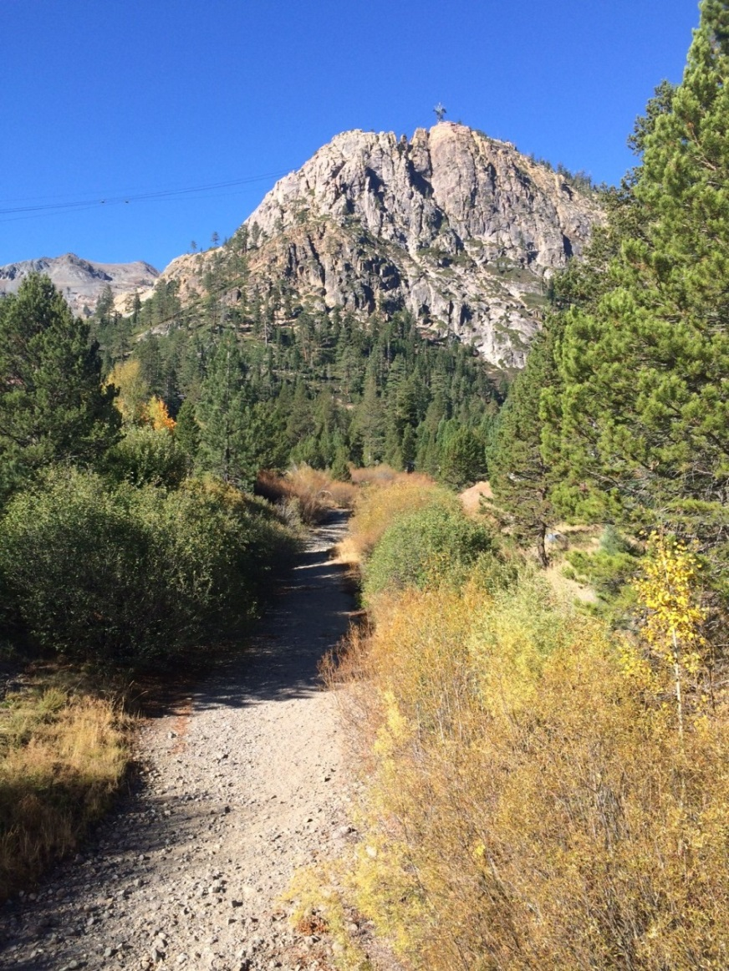
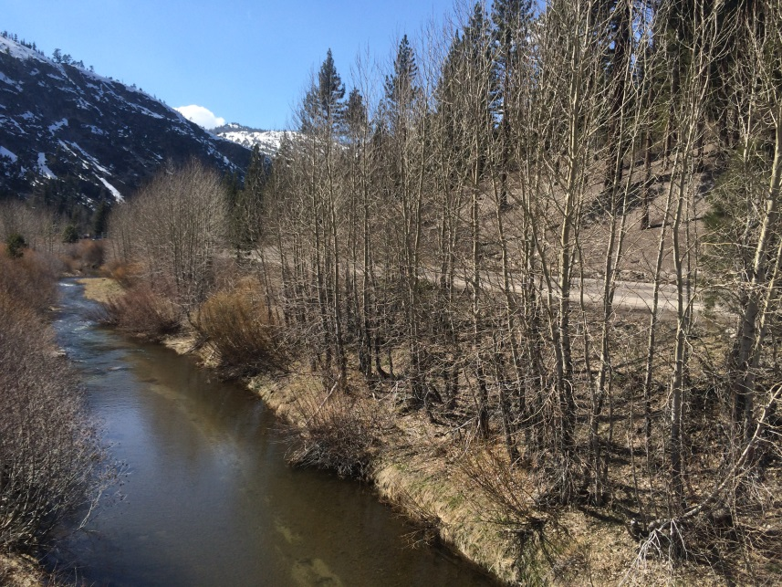
Squaw Creek
Restoration

Slide 9
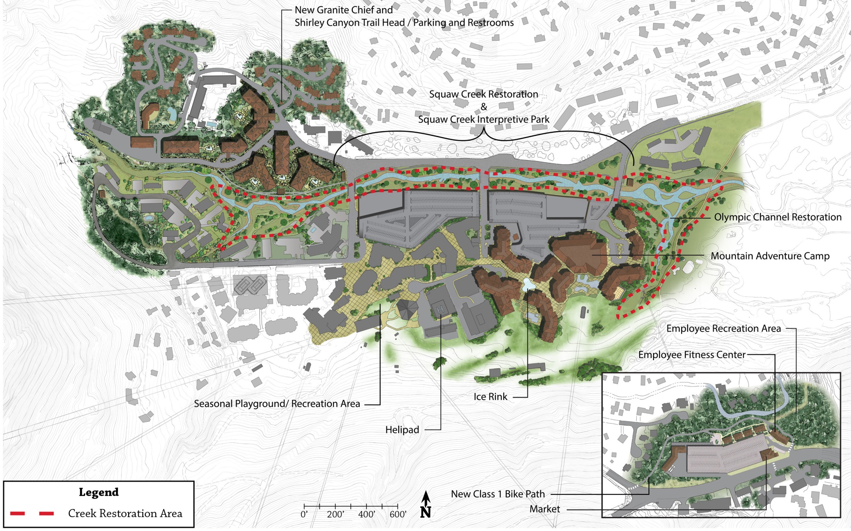
Comprehensive Restoration

Slide 11
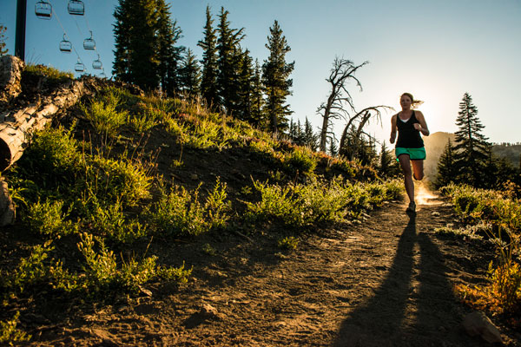
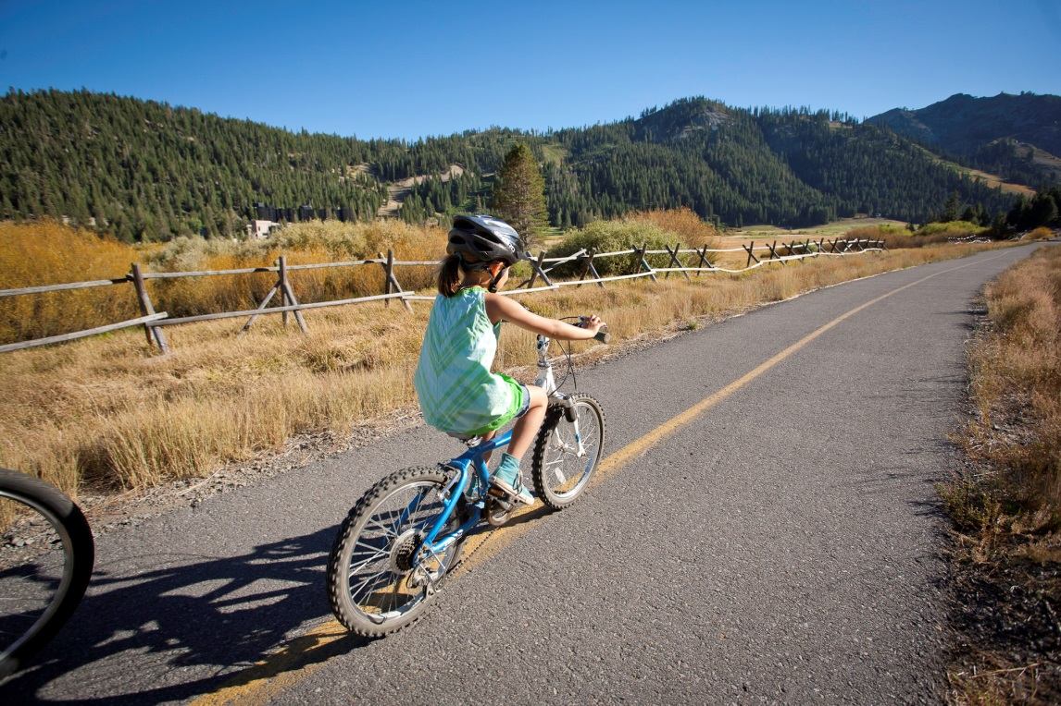
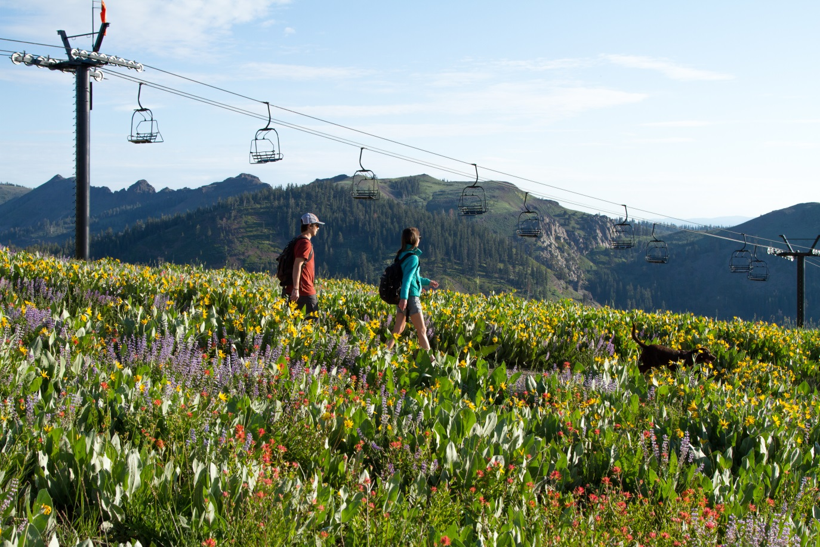
Parks and Recreation: New hiking and biking trails

Slide 12
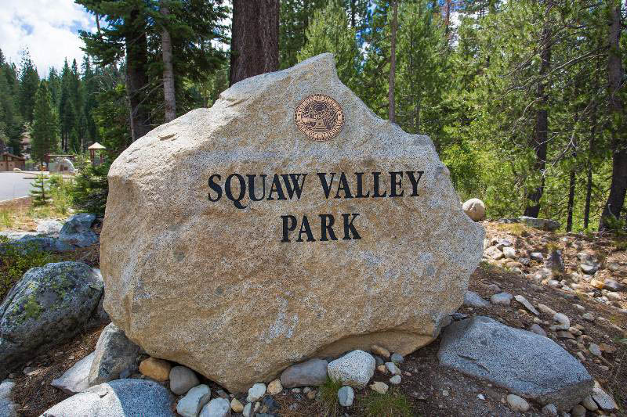
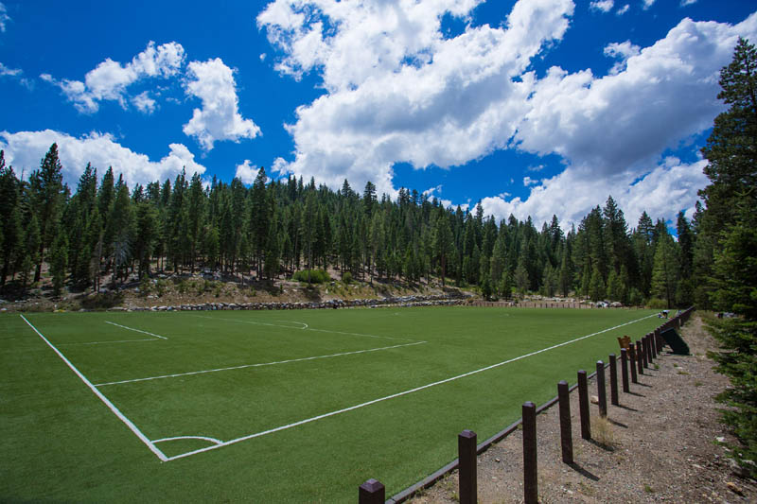
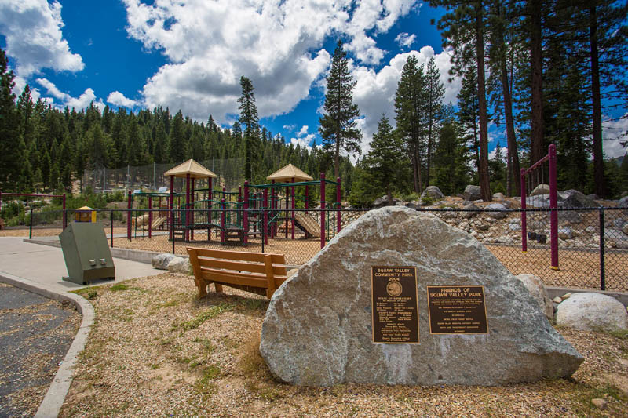
Enhancements to the Squaw Valley Park :
flush restrooms, water fill stations, new directional signage and lighting.

Slide 13
Economic
Benefits

Slide 14
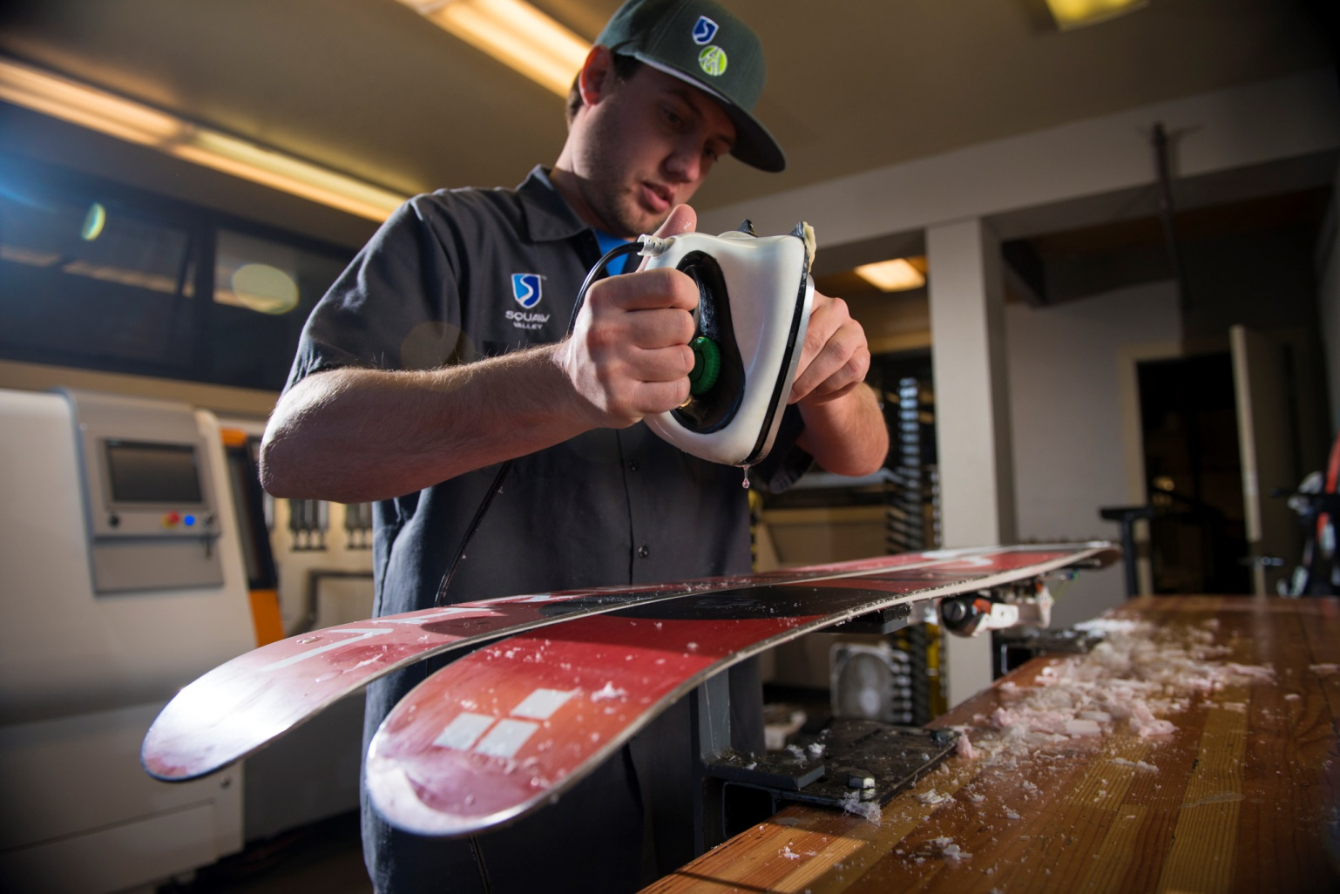
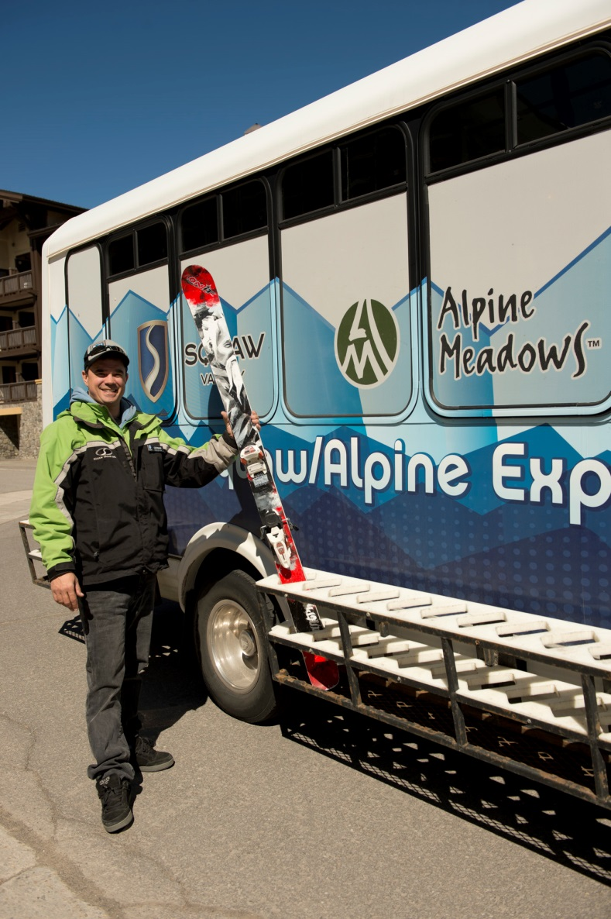
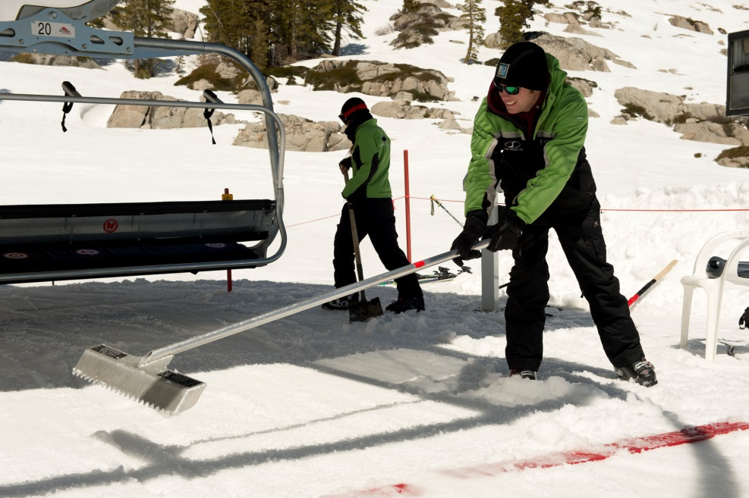
Jobs:
Over 1,400 new full and part time jobs generated from Village redevelopment.

Slide 15
Tax Revenue
by Source
Total Annual Revenue: $22,640
*$ in ‘000’s

Slide 17
Environmental Benefits

Slide 18
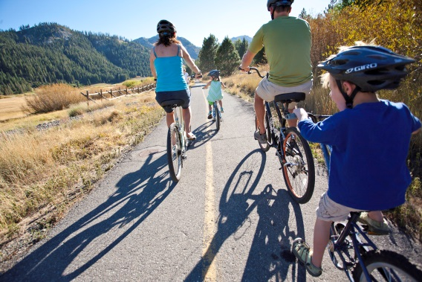
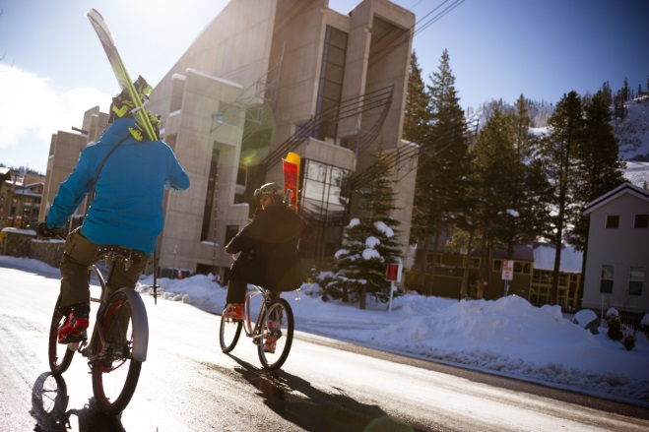
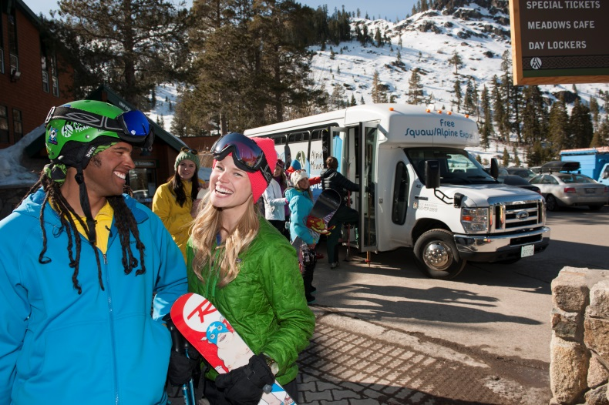
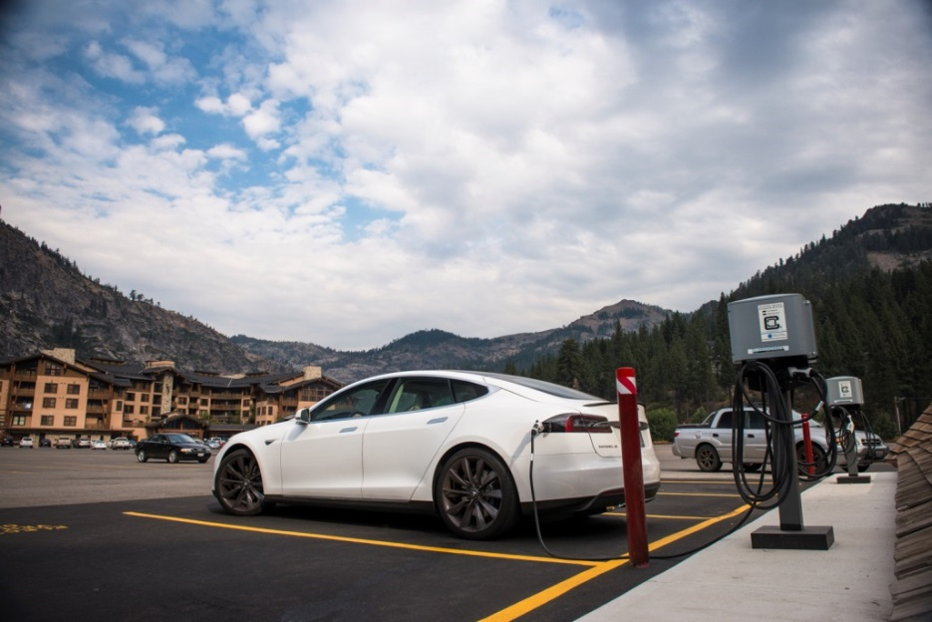

Slide 19
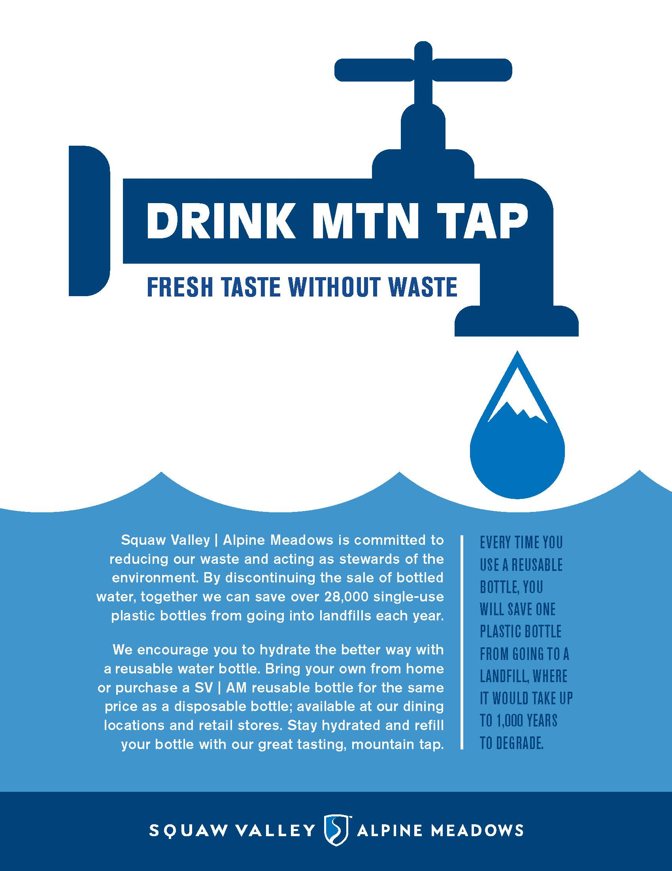

Slide 20
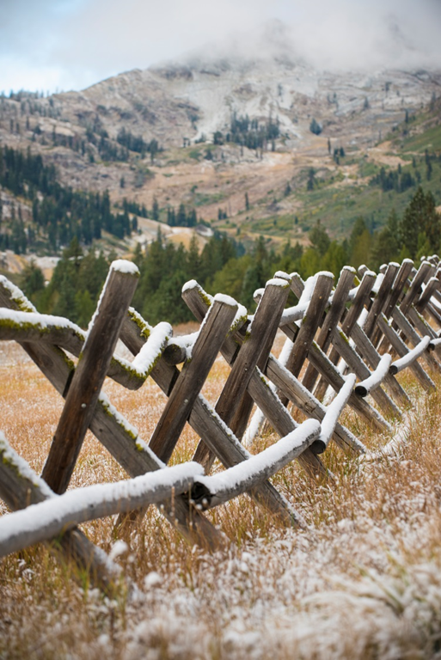
Planning/Approval Schedule
2016
Final EIR
April 2016
Planning Commission Hearing
May 2016
Board of Supervisors
July 2016

Slide 21
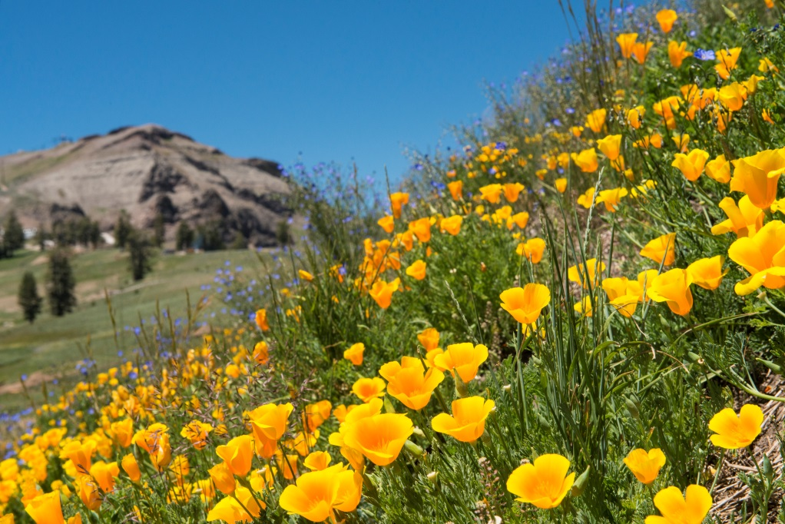
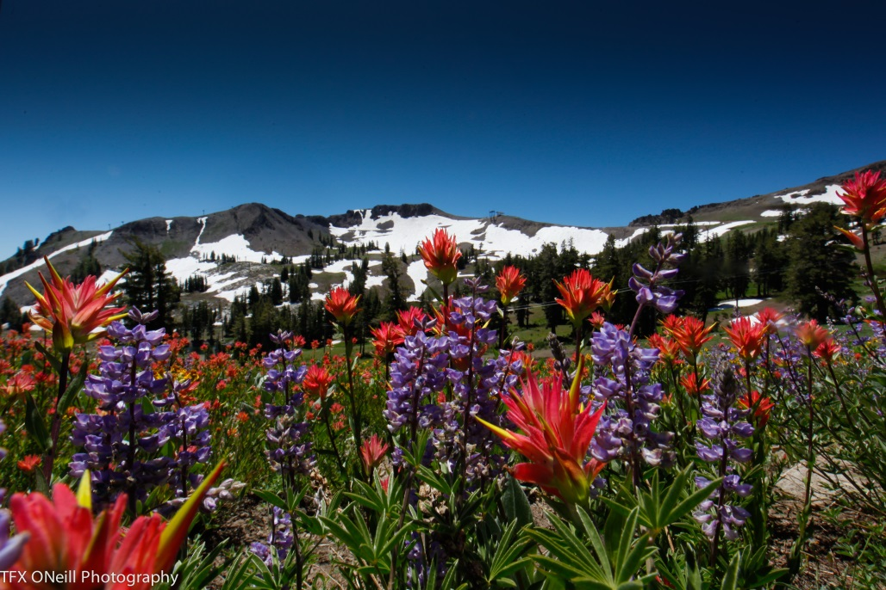
Thank you!
Questions?

