Slide 1
Tourism Development, Visitor Service and Membership Update

Slide 2

Program Updates
General Consumer Update
18.19 Marketing Coop Budget Breakout
Media Flowcharts
Events
Leisure Sales
Conference Sales
Visitor Service and Membership

Slide 3
Tourism Development Consumer Updates
SMARI Research wrapping up – data to be finalized early August
Summer Consumer efforts underway- Targeting Flight Markets – NY, LA, Austin
Noteworthy Publication Placements – Average Advertising Equivalency $112,759
  NCGA Golf Magazine
  RGJ: Reno-Tahoe’s Top 12 annual big events and festivals
  Red Tricycle: No Snow Needed: Tahoe in the Summer
  SacBee: Fireworks, parades and more fireworks!
  Tahoe Weekly: 4th of July celebrations
  VIA: The Best Lakes for Summer Fun in the West
  Craft Beer Connoisseur– 15 Unique Ale Trails
  The Mercury News – 5 fab Lake Tahoe restaurants for lakeside dining
Social Media
1,950 New Fans across all platforms – FB, Twitter, Instagram
Two Influencer Visits –
  Elisabeth Brentano - Followers: 87.5k followers
  Location: Palm Springs, CA
  Naude Heunis -Followers: 21.8k followers
  Location: South Africa
Events
Wanderlust At Squaw Valley July 19-22

Slide 4
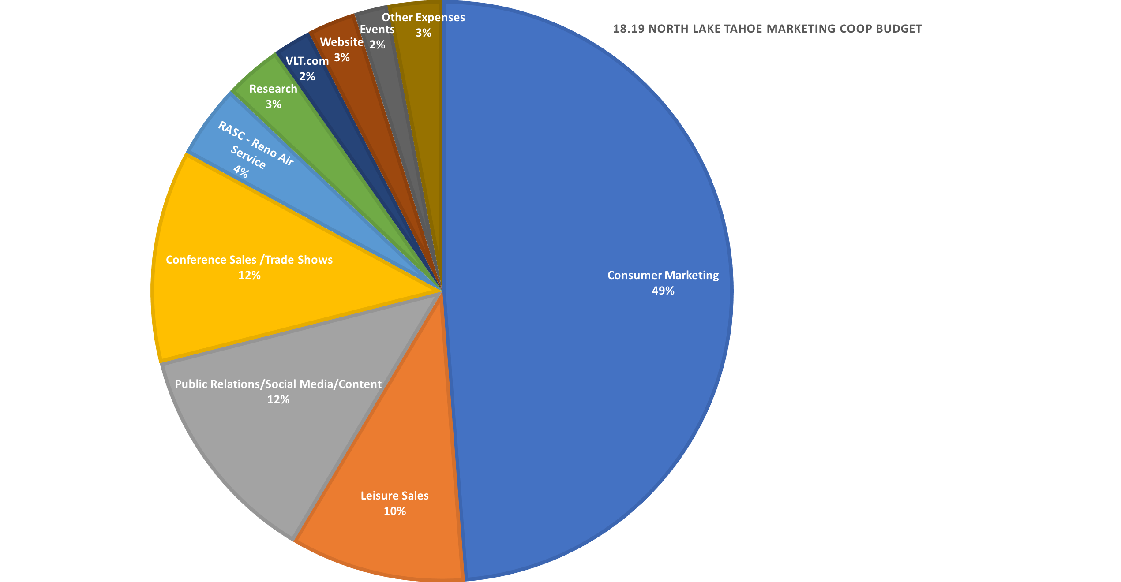
$1,175,279 | Consumer Marketing
$235,445 | Leisure Sales
$301,080 | Public Relations/Content
$286,295 | Conference Sales/Trade Shows
$100,000 | RASC - Reno Air Service
$78,350 | Research/Destimetrics
$51,000 | VisitingLakeTahoe.com
$65,000 | Web Content Manager/Web Maintenance
$45,000 | Special Events
$72,374 | Other Operational Expense - ex) fulfillment/mileage, weather cams
$2,409,823 | TOTAL
*Full Budget Detail to be handed out

Slide 5
18.19 Consumer Media Flowchart

Slide 6
18.19 Meetings/Conference Media Flowchart

Slide 7
Special Events
Overview and 18.19 Detail

Slide 8
2018/2019 Special Event Strategy
Program Overview
2015 Tourism Master Plan
Special events are an key objectives to achieving the Marketing & Sales primary goal set in the master plan.
Bring more visitors to NLT who stay longer, return often and travel during the off-peak periods,
while maintaining affinity with the NorCal/Bay Area consumer and continuing to expand group business.
Key Trend Insight
Since 2008, comparable destinations have increasingly focused on special events to motivate visitation.
Purpose of Event Sponsorships
  Drive overnight visitation
  Enhance visitation in “strike” zone periods – seasonal, mid-week, regional (lake vs. mountain resorts)
  Capitalize on events that provide a marketing and/or PR reach to NLT targeted audiences
  Enhance the NLT brand
Measurements of Success
  ROI Calculations
  Survey Results
  Tracked Lodging & TOT Generation
  Marketing & PR Exposure
  Community Impact
  Collaboration & Transparency with Regional Partners During Negotiation Process

Slide 9
ROI Measurements
Return on Investment (ROI) = Average Economic Impact
Sponsorship Funds
Average Economic Impact =
(Visitors Contributing to TOT x Average Night Stay) x Average Spend Per Person Per Day
Visitors Contributing to TOT =
((Total Event Attendance x % Out of Town Visitors) x % Lodged in TOT Generators) x % in Placer County
Information is collected via participant survey

Slide 10
Total Event Spend
2016/2017 FY
NLTRA: $481,017
NLT Coop: $15,000
2017/2018 FY
NLTRA: $502,395
NLT Coop: $50,000
2018/2019 FY
NLTRA: $563,225 (Forecast)
NLT Coop: $50,000 (Forecast)
* Includes completed events with a post event report as of 7/27/18.

Slide 11
Event Support by Region – 2016/2017 Fiscal Year

Slide 12
Event Support by Region – 2017/2018 Fiscal Year

Slide 13
2018/2019 Special Event Budget
Spartan World Championships $254,500
Autumn Food & Wine Festival $37,375
Wanderlust Festival $37,700
Tough Mudder Tahoe $35,550
Tahoe Lacrosse Tournament $5,000
4th of July Fireworks $20,300
Freeride Festival $15,000
Hot August Nights Squaw $10,000
Mountain Travel Symposium $5,000
Broken Arrow Skyrace $20,000
No Barriers $12,400
Winter Wondergrass $19,400
New Event Development $33,000
Partnership Funding Program $50,000
Event Operations $8,000
Total Budget: $563,225

Slide 14
2018/2019 Special Event Strategy
Marketing Sponsorships
Budget: $485,225
Qualification Criteria
  Room Nights Generated – greater than 100
  Average Night Stay – at least/greater than 2.5
  Media/PR value – greater than $25,000
  Quality of Event and Producer Experience
  Built-In Audience Capabilities
  Target Audience Alignment–at least 2/category
    Human Powered Sports
    Cultural
    Culinary
    Health & Wellness
Funding
Review sponsorships annually to ensure continually beneficial to region. A general guideline of funding for a successful events is as follows:
  Years 1 – 3: 100% of original funding
  Years 4 – 5: 75% of original funding
  Years 6 – 7: 50% of original funding
Incubator Funding
Startup events initially directed through Partnership Funding if don’t confidently qualify for a Marketing Sponsorships.
  After year one, if NLTRA Staff and BOD feel event has large potential, incubator funding can be utilized to support the event on a greater level
Utilized to attract promoters of other successful events to replicate events in the NLT region
Reserve Funding
Explore creating an Event Reserve to cover multi-year contracts. Currently the Marketing Reserve is relied upon in the case of reduced future funding.

Slide 15
2018/2019 Special Event Strategy
Partnership Funding
Budget: $50,000
Qualifications
Marketing of regional events that generate overnight visitation to Placer County
Intended for smaller-scale events that don’t qualify for Marketing Sponsorships
Funds allocated through an application process
Program operates on a calendar year
Program Modifications
New for the 18/19 FY, staff proposes funds be used to supply in-kind support versus a cash sponsorships
Staff would work with agencies to create social, digital and PR ads/content to advertise the selected events
Event producers would work with staff and agency contacts to determine appropriate audience and markets
Program Timeline
Applications, Selection Panel Presentations & Funding Allocation Recommendations – October 2018
BOD Review & Possible Approval – November 2018

Slide 16
2018/2019 Special Event Strategy
Additional Event Funding
Visitor Services/Experience Funding
Budget: $20,000
Qualifications
Regional events that provide visitors services and experiences expected/necessary of the region
  Example: Tahoe City and Kings Beach 4th of July fireworks shows to ensure continuation
Presence at Out-of-Market Events
Budget: Included in the $33,000 New Event Development Line Item
Program Details
Earmarked to give NLT a presence at out-of-market events
  Leverage current Marketing Sponsorship partnerships to secure booth space at targeted events
  Explore other event options as necessary
Goal is to bring an experiential marketing presence to at least 2 events/year, located in target markets that aligning with consumer brand pillars
  When appropriate, NLTRA will invite partners to attend as well

Slide 17
Leisure Sales
Strategy & Program Development

Slide 18
Today’s Overview
Leisure Sales Areas of focus
Leisure Sales Strategy
Understanding the business models & companies within the leisure sales world
Product Development in North Lake Tahoe
How we track international visitation to North Lake Tahoe
Notes:
Goal – to support shoulder season, to hit the consumers and international visitor who is booking a longer stay and flexible with their travel dates.

Slide 19
Leisure Sales: Areas of Focus
International Media → PR Contract with Australia & Contract FAM work with Abbi Agency
Domestic Travel Trade → Online Tour Operators (OTAs), Domestic Wholesale and Receptive Tour Operators
International Travel Trade → Canada Office with Destination Counsellors International, UK/Ireland Office with Black Diamond, Australia office with Gate 7
Tier 1 Markets → USA, United Kingdom/Ireland, Australia/New Zealand, Canada, Mexico
Tier 2 Markets → China, France, Germany, Brazil
New Emerging Markets → India, South Korea, Argentina
Notes:
International offices – we go through an RFP process every (3) years for our International offices with committees made up of volunteers from our community
Our international offices – we have had Black Diamond & Gate 7 for 10+ years and our new Canada office relationship launched in August
These offices are also the same international offices that Visit California has.
Tier 1 & Tier 2 markets are identified from our state offices and our visa vue tracking data which we will learn more about later on.

Slide 20
Leisure Sales: Strategy
Press Trips → Work closely with industry partners to curate itineraries that highlight the destination. NLT’s goal is to host qualified media FAMs from our Tier 1 & Tier 2 markets, up to twelve annually.
Trade Familiarization Tours → To bring influential travel sellers to NLT to education on the destination and products that can be promoted to consumers through travel agents and tour operators. This assists with influencing travel decision-making and shapes how the destination can be packaged.
Tradeshows & Sales Missions → Attend industry tradeshows and events, both internationally and domestically, to connect with key markets and expand NLT’s brand awareness.
Product Development → Increase lodging and activity product available to travel agents and tour operators in order to increase sales to the destination during both non-peak and peak times.

Slide 21
Leisure Sales: Strategy
Partner Relationships → Build relationships with local and state partners; including, RSCVA, South Lake Tahoe, Visit California, Travel Nevada, Reno Tahoe Territory, High Sierra Territory and NLT partner resorts and activity providers.
Marketing Collaboratives → Increase brand awareness and booking demand in key markets through marketing campaigns.
California Star Program → Visit California’s travel trade digital platform to engage with travel trade audiences on a global scale. This tool is used for education and content distribution.
Data Tracking → VisaVue Tracking Program provides us reporting on international and domestic travelers to North Lake Tahoe.
Notes:
Marketing Collaboratives are efforts we make within some of our sales channels, such as expedia (online tour operator) to increase sales in need periods – Mid week and shoulder seasons
An example would be Expedia – for every $1 NLT and our partners put in, we saw a $41 return on investment
These programs create brand awareness and bookings through marketing campaigns.
Data Tracking:
This is just a snapshot (roughly 20%) but gives us insight into what countries are visiting NLT and when they are visiting.

Slide 22
Leisure Sales
Understanding the Booking Channels
Travel Trade Industry
Trade Focused
Receptive Operators
(US based companies that sell to internationally based companies)
Examples:
HotelBeds, ATI, GTA, Tourico & Bonotel
International Wholesale
Examples:
Funaway Holidays, Virgin, Helloworld, Blue Powder Tours, Excite Holidays, etc.
Domestic Wholesale
Examples:
Ski.Com, Rocky Mountain Getaways, & Undercover Tourist

Slide 23
Leisure Sales
Direct to Consumer
Travel Trade Industry
Direct to Consumer
OTA’s (online travel agents)
Expedia, Booking.com, hotwire.com
Travel Agents

Slide 24
Product Development
Increasing lodging & activities available for sale
Increased Product Placement: Increased Brand Awareness in 2017:
HotelBeds: (2) hotels in 2015 to (7) hotels in 2017 Tradeshows/Sales Missions: 14
  Including small properties International PR Trips: 12
GTA:(1) hotel in 2015 to (3) hotels in 2017 Travel Trade FAMS: 16
Tourico: (1) hotel in 2015 to (3) in 2017 Site Inspections: 24
Bonotel: (2) hotels in 2015 to (5) hotels in 2017
  Increased activity product as well
Notes:
This is really important because these are our FIT (Foreign international travelers) filling up your hotels and your activities.
I will take Hotel Beds as a great example
HotelBeds alone brings 1 million dollars of annual revenue to North Lake Tahoe in lodging sales alone. So the more hotel product available for sale, the more we will see an increase of bookings and TOT to the destination
Something really exciting is that all hotels, no matter the size can work with the bulk of these travel agencies or tour operators. (3) of our small lodging properties around the lake have been added to these channels.

Slide 25
Tracking International Markets…
We take into consideration data provided by both Visit California & Travel Nevada.
In 2016, we signed on to track international visitation through Visit California’s VisaVue Data Tracking Program.
2016 Annual Data: 2017 Annual Data
$4,424,284 $5,297,706
2.6% growth from 2015 19.7% growth from 2016
Average cardholder spend: $252.95 Average cardholder spend: $264.51
Top Countries
United Kingdom *
Canada
Australia *
China
Mexico *
France *
Germany
Top Countries
United Kingdom *
Canada
Australia *
China
Mexico *
France *
Germany
Argentina

Slide 26
Conference Sales

Slide 27
Conference Sales – Key Functions
Generate group sales leads for hotel partners
Act as a liaison between meeting planners and hotel partners during the sales process. (single point of contact)
Assist hotels in converting leads into booked business
- Coordinate and execute client site visits
- Attend trade shows in key strategic markets
- Conduct sales calls/customer events in strategic markets

Slide 28
Conference Sales: Strategy
Strategic Markets→
California. Which historically generates roughly 70% of conference bookings. Primarily in Northern California but with significant efforts in southern California as well.
Cities with Significant Air Lift into Reno/Tahoe International Airport. Those destinations include San Francisco, Los Angeles, Portland, Dallas and Phoenix.
Washington DC and Chicago where the majority of national associations are headquartered.

Slide 29
Conference Sales: Strategy
Media Plan→ Annual media plan that includes print and digital advertising in various meeting industry outlets regionally and nationally. The plan also includes a small presence on social media.
Tradeshows & Sales Missions → Attend industry tradeshows and conduct sales calls in key markets. The current trend is away from the large national tradeshows which have generally been showing decreased response and towards smaller, regional appointment-based shows which have provided better results.
In Market Customer Events→ Host customer events in key strategic markets. These events are an excellent way to interact and build relationships with customers in a less formal but very memorable setting. FY 2018-2019 events will include a San Francisco Giants game, San Jose Sharks game, a cooking class and Topgolf in Sacramento.

Slide 30
Conference Sales: Strategy
Familiarization Trips → Bring customers with current or future business to North Lake Tahoe to experience the destination first hand with the goal of influencing them to bring their meetings to the area.
Strategic Partnerships with “Third Parties” → Continue to build on the strategic partnerships we have developed with HelmsBriscoe and HPN. This year staff will attend the HB Annual Business Conference, HPN Annual Partner Conference and ConferenceDirect CDX.
Create a Client Advisory Board (CAB) →The Board will consist of a representative group of professional meeting planners and industry leaders who will meet periodically to offer knowledge of the meeting and hospitality industry and advice on strategy and innovative programs for North Lake Tahoe group sales initiatives. The Advisory Board is intended to be a catalyst for the creation of market centric, client focused ideas with the intent of generating additional group bookings.

Slide 31
Total Conference Spend
2016/2017 FY
$286,000
2017/2018 FY
$294,890
2018/2019 FY
$286,295

Slide 32
How we track success – Lead Generation

Slide 33
How we track success – Room Revenue

Slide 34
Visitor Service, Membership and Communications Update

Slide 35
Visitor Information Services
Visitor Services
Visitors Served FY 17/18: 61,359 (up 12%)
Staffing Update
Driving visitation through a variety of methods
Implementation of Visitor Surveys & Referral Tracking
Looking Ahead
Hospitality Trainings
Distribution List Organization
Retail Training & Inventory Organization
Visitor Center Enhancements
Lodging Committee Reactivation
Visitor Guide
Distribution: regionally, 70,000 in print
Added two locations: RTIA & California State Fair

Slide 36
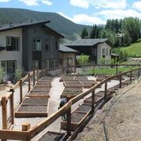
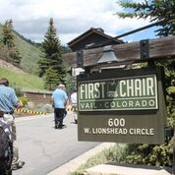
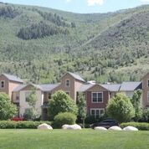
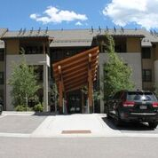
Communications Overview
New Website: www.NLTRA.org
Contract awarded to SDBX Studios
Projected launch: Monday, Oct. 1
FY 18/19 Tasks & Benchmarks
Newsletter Updates
Social Media Growth
Public Relations Outreach
Local Achievable Housing Advocacy
Representation on Mountain Housing Council
Attended TREK Seminar in Vail, CO
Advocate for Placer County Project
Member Education
1. TOT Ordinance Revision
2. McClintock & Morse Debate
Notes:
Newsletter: redefining content categories and themes, distribution lists, open-rates/engagement and design for branding consistency
Social Media: real-time updates, community highlights, informational resources, live video, growth
Public Relations: local outreach, press conference opportunities, media engagement at events
Represented North Lake Tahoe at the TREK Seminar in Vail to address housing problems and solutions within similar mountain communities (attendees included: TRPA, Placer County, Town of Truckee, Mountain Housing Council, among others). Key learnings / notes can be emailed at your request.

Slide 37
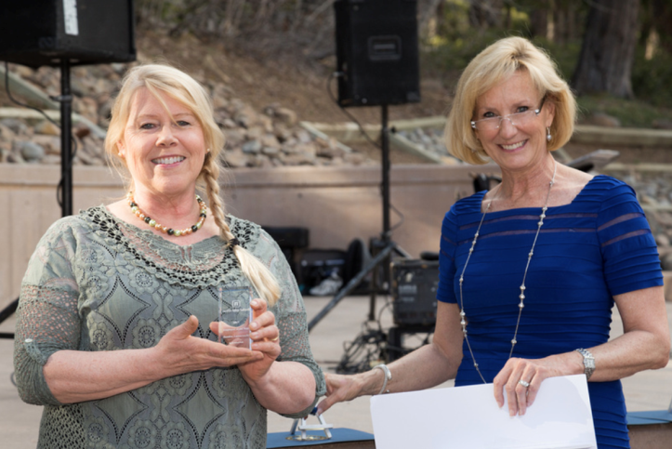
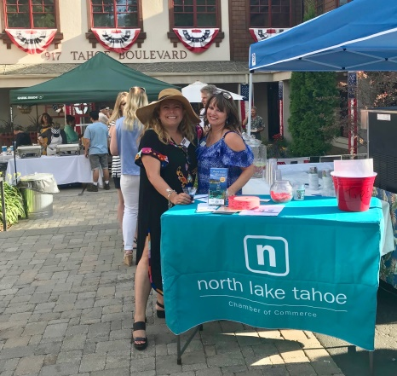
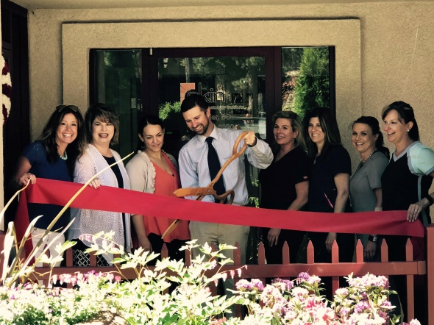
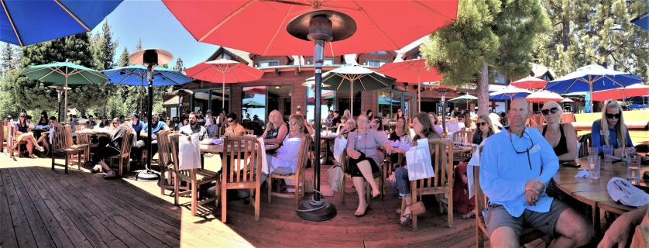
Membership Overview
Chamber Snapshot
386 Members
Membership Revenue: FY 17/18 = $114,000
Membership Revenue: FY 18/19 = $128,000
Goal: Increase awareness of Chamber services
Goal: Raise Chamber revenue by providing additional services
Goal: Increase Sponsorship Opportunities & Events ($70,510)
Master Calendar
Mixers: monthly on Thursday
Breakfast Club: monthly on the first Tuesday
Community Awards (April)
Seasonal Recreation Luncheon (May)
Membership Luncheon (October)
Shop Tahoe: Small Business Saturday
Business Seminars & Training
Notes:
Membership Goal: increase membership by 20% -- 80 new members
Increase Chamber Services & Awareness: Business Seminars & Trainings: hospitality, social media, employee sustainability, and more!
Event Sponsorship: $70,510 is FY 18/19; FY 17/18 was $65,900 (includes Community Awards - $50K, Rec Luncheon - $8K, Breakfast Club - $6,960, Mixers/Events - $2,500)

Slide 38
Membership Overview

Slide 39
Save the Date
A U G U S T
Dollar Hill Local Housing Community Initiative at TCPUD Board Room: Wednesday, August 1 @ 3-5pm
Tuesday Morning Breakfast Club at Granlibakken: Tuesday, August 7 @ 7-8:30am
Chamber Mixer at the Visitors Center in Tahoe City: Thursday, August 9 @ 5pm-7pm
TOT Ordinance Revisions (location: TBD) : Monday, August 20
S E P T E M B E R
Tuesday Morning Breakfast Club at Granlibakken: Tuesday, September 4 @ 7-8:30am
Chamber Mixer - at Sierra Nevada College in Incline Village: Thursday, September 20 @ 5pm-7pm
Business Training: Media Buying & Pitching
O C T O B E R
* Membership Drive *
Tuesday Morning Breakfast Club at Granlibakken: Tuesday, October 2 @ 7-8:30am
Chamber Mixer - at Granite Peak Management in Alpine Meadows: Thursday, October 11 @ 4pm-6pm
Business Training: Social Media (in conjunction with TCDA + NTBA)

