Slide 1
North Lake Tahoe FY 18/19 Overview

Slide 2
Creative Strategy
Objectives:
Position North Lake Tahoe as a four-season destination; reinforce multi-town experience & leverage differentiators
Attract & motivate audiences by evoking emotion and creating a deeper connection through positioning, visuals and copy
Increase midweek travel and/or extended overnight stays
Notes:
Spontaneous or shorter booking window for drive markets; longer-lead planning for fly markets
Messaging: are we speaking to potentially new folks or those only vaguely familiar or people like in the Bay Area who already have a strong understanding of NLT
Awareness of experiences: this includes events, which is a huge driver of travel
Leveraging trends: Health & Wellness travel interests, Instagram-friendly destinations, rise of the conscious traveler, etc.

Slide 3
Creative Strategy
Seasonality & Positioning:
Spring: Twice the Fun/Dual Days
Summer: Summer’s Official Playground
Fall: Secret Season
Winter: Winter Wow
Notes:
- Optimize and test

Slide 4
Creative Strategy
Brand Standards
Value proposition
Brand positioning
Messaging strategy to establish cohesive voice/tone

Slide 5
2018 Summer

Slide 6
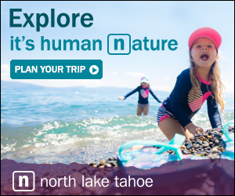
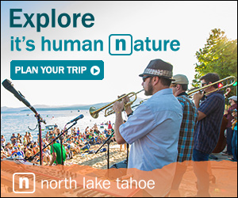
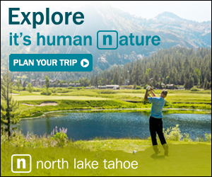
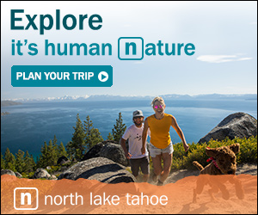
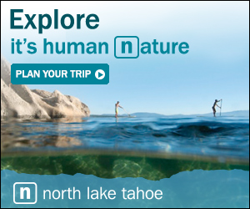

Slide 7
2018 Summer Performance
The Summer 2018 campaign served nearly 23 million impressions across display, paid social, paid search, email, and online video channels. This resulted in over 40K visits to GoTahoeNorth.com and 11.8K time on site conversions. Overall, the average cost to acquire a high-quality site visitor (spending more than 115 seconds on the site) was $14.
Paid Social ads drove the highest volume of traffic to the site, while also producing a high volume of time on site and book now conversions. Notably, the introduction of Snapchat ads, Instagram story ads, and dynamic creative on Facebook resulted in more efficient ad spend, including a 40% improvement in cost per click (compared to the prior year).
Email ads were able to produce high quality visitors at a very low cost ($4 cost per conversion), followed closely by display ads ($11 cost per conversion). TripAdvisor placements accounted for 73% of all display conversions and averaged a $2 cost per conversion – the lowest among any placement during the Summer campaign.

Slide 8
Summer Creative
Average CTR – 0.08%
Conversions – 3,617
Total Clicks – 4,112
CTR and total clicks are consistent across the board for summer. However, the general messaging accounted for 91% of all conversions. It is believed that this was before directing to the season specific landing pages so the messaging may have been more consistent with a home page experience.

Slide 9
2018 Fall

Slide 10
Discover North Lake Tahoe’s Secret Season
Fall is an amazing time to experience North Lake Tahoe. The crisp mountain air, bold colors and uncrowded towns make it the perfect place to escape. It's in our nature to make the most of life – to step outside of your day-to-day, experience something new and seize every minute. In North Lake Tahoe, our nature is your nature; a place that elevates all of life’s moments. Amongst the backdrop of crystal blue shoreline and towering mountains is where you can connect with nature, clear your mind and uplift your spirit. Come up and breath it in–experience why life is naturally elevated up here. North Lake Tahoe, It's Human Nature

Slide 11
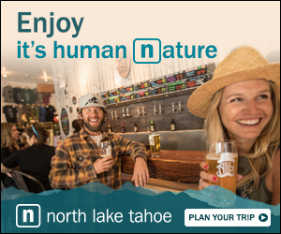

Slide 12
Fall Performance
The Fall 2018 campaign served nearly 6.8 million impressions across display, paid social, paid search and email channels. This resulted in over 11K visits to GoTahoeNorth.com and 5K time on site conversions. Overall, the average cost to acquire a high-quality site visitor (spending more than 115 seconds on the site) was $9.90.
Paid Social ads drove the highest volume of traffic to the site, while also producing a high volume of time on site and book now conversions. Notably, the introduction of Snapchat ads, Instagram story ads, and dynamic creative on Facebook resulted in more efficient ad spend, including a 40% improvement in cost per click (compared to the prior year).

Slide 13
Fall Performance
Average CTR – 0.07%
Conversions – 3,914
Total Clicks – 3,908
The general creative for Fall performed the best with a CTR of 0.09% and generated the bulk of conversions and clicks suggesting a more general message for shoulder seasons might be more appealing.

Slide 14
Winter

Slide 15
Winter that Wows, It’s Human Nature
Welcome to a one of kind, winter experience. Unified by 12 unique towns, the North Lake Tahoe adventurous spirit will open up your mind and awaken your winter soul. Home to North America’s highest concentration of ski resorts, snow seekers will also discover budget friendly options for all skiers and riders. Heighten your senses and find your own comfort zone with local beer and cuisines crafted for comfort. The majestic lake view, blanketed with pillows of snowflakes will create memories that last a lifetime. Discover a destination that’s waist deep with winter wow. North Lake Tahoe, It’s Human Nature.

Slide 16
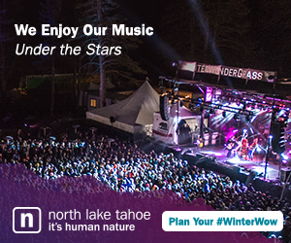
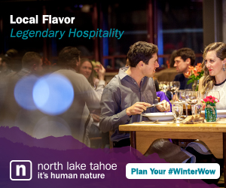
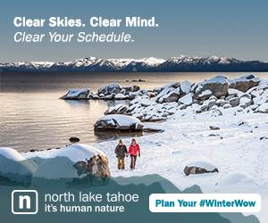
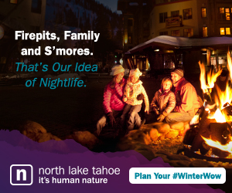
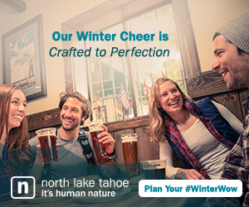

Slide 17
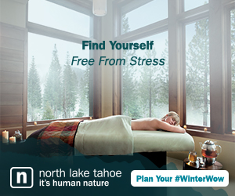
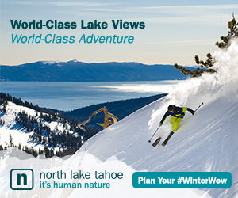
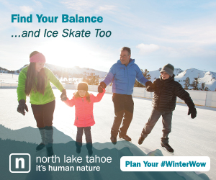
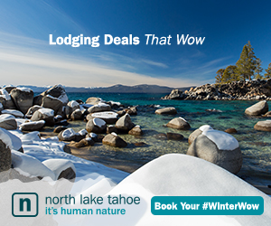
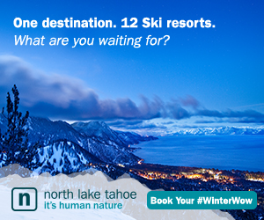

Slide 18
Winter Performance
The Winter 2019 campaign served 18.6 impressions resulting in 57,319 clicks. The campaign led to 13.8K website visits with an average time on site of 26 seconds and 1.4 average page per session. These visitors directly led to 2.0K time on site conversion and 259 book now conversions.
Paid Search ads drove the highest quality site traffic, resulting in 3.1K website visits, with an average tie on site of 51 seconds and 262 book now conversions. Paid Search ad drove the most traffic to site with 3.1K sessions. They also led to 607 TOS conversions and 256 book now conversions.
The most efficient channel during this campaign was email with an average cost per conversion of $11.64.

Slide 19
2019 Spring

Slide 20
Spring: Twice The Fun
They say good things come in pairs. Like late season skiing paired with an early afternoon paddle. Taking in the sights of a high sierra sunset and sharing laughter into the night while making s’mores around the fire. Uncrowded trails leading to an untouched lakeshore. Mountainside adventures with a calling for lakeside relaxation. In North Lake Tahoe, dual days thrive, elevating every spring day into an extraordinary experience. Take an easy drive up and discover how springtime adventures are twice the fun. North Lake Tahoe, It’s Human Nature.

Slide 21
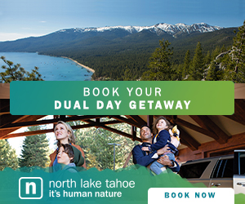
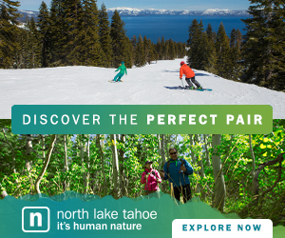
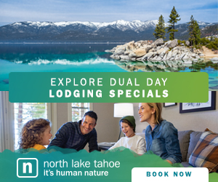
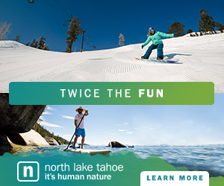
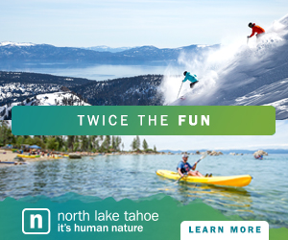
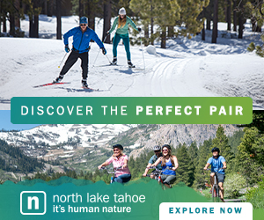

Slide 22
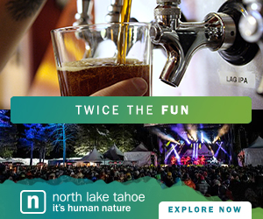
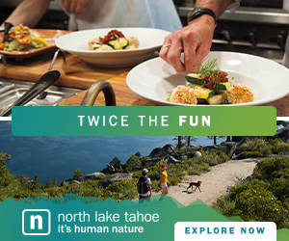
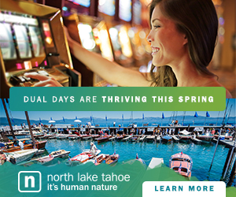
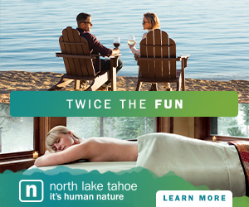
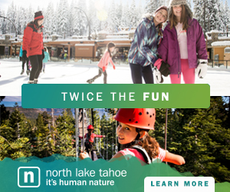
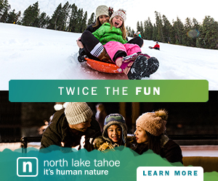

Slide 23
Spring Performance
The Spring creative served approximately 16 Million impressions and 29,500 visits to the website.
The ads drove 8,819 Time on Site Conversions and 1,390 Book now conversions (with bulk of those coming in June)
Users coming from Paid Search continue to see the longest time on site of all mediums.

Slide 24
Spring Performance
Average CTR of 0.12%
Conversions – 3,284
Total Clicks – 11,483
Creative performed pretty consistently across the personas with Outdoor and retargeting messaging performing the best with an average 0.10% CTR; however, the outdoor creative generated the bulk of the conversions with a total of 2,243 (68%).

Slide 25
Looking Ahead

Slide 26
2019 Summer

Slide 27
Summer’s Official Playground
Most of us can’t wait till summer to get away. It’s that stirring deep inside each of us that longs to escape. School’s out. The sun’s out. And our desire to get out and enjoy it is human nature. Thankfully, North Lake Tahoe is the perfect place to escape the nine to five with a thriving summer scene loaded with experiences meant to refresh, recharge and reinvigorate our souls. There is no shortage of activities to check off everyone’s list – from a scenic paddle to a picturesque hike, to lounging on the beach to hitting up the gaming and dining scene – there’s so much to do in Summer’s Official Playground. North Lake Tahoe, It’s Human Nature.

Slide 28
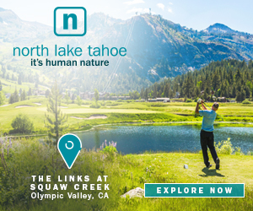
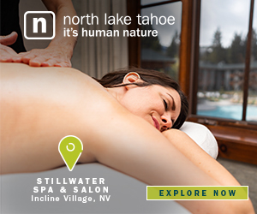
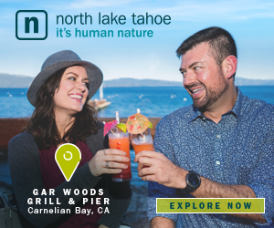
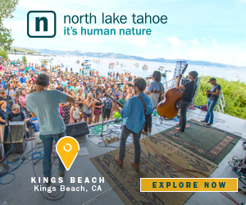
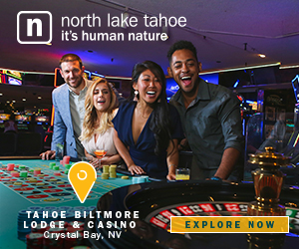

Slide 29
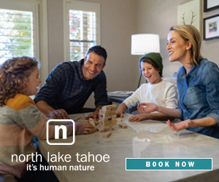
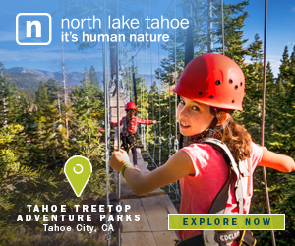
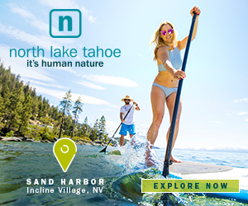
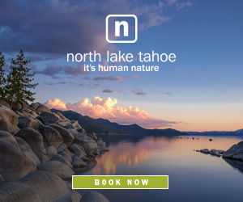

Slide 30
Thank You!

