Slide 1
TBID UPDATE
August 27, 2019
Notes:
Introductions –

Slide 2
COUNTY TRANSIENT OCCUPANCY TAX - $18 MILLION CURRENT USES:
PLACER COUNTY BASE TOT - 8%
EASTERN COUNTY - 2%
Placer County
TOT
40% = $7.2 M
County General
Services in
Tahoe
Placer County
TOT
18.9% = $3.4 M
Specific Tahoe
Services
Placer County
TOT
21.1% = $3.8 M
NLTRA
Marketing,
Visitor Info
Placer County
TOT
20% = $3.6 M
Infrastructure
&
Transportation
Placer County
TOT Total
$18 million

Slide 3
NORTH SHORE REGION AT A COMPETITIVE DISADVANTAGE
Despite success and improvements in KPIs North Shore still at competitive disadvantage - infrastructure & transportation systems deficient, shortage of workforce housing
Competition has more funding to address these needs and, as a result, has better infrastructure and transportation systems
Competition have larger marketing budgets
2015 North Lake Tahoe Tourism Master Plan identified and addressed these issues and developed action plan

Slide 4
county tourism master plan recommends additional spending
Tier 1 Priorities – Summary of Additional Funding Needs
 |  | Annual | 8 Year Estimate
 | Visitor Activities & Facilities | $ 7,096,250 | $ 56,770,000
 | Transit | $ 3,100,000 | $ 24,800,000
 | Marketing/Visitor Information | $ 2,200,000 | $ 17,600,000
 | Total Additional Funding Needed | $ 12,396,250 | $ 99,170,000
NLTRA BOARD ALIGNS WITH MASTER PLAN RECOMMENDATIONS
Notes:
Our efforts in marketing, promotions, and visitor services are important
but additionally both NLTRA and Placer County adopted a Tourism Master Plan in 2015 that identified other priorities for funding –
Visitor Activities & Facilities and Transportation
That adopted plan was developed after extensive public outreach and input and identified the need for significant additional funding – projected need of $100 million just for Top Tier Priorities over the 8 years remaining on the current
It also identified the need for additional funding sources including consideration of the formation of a Tourism Business Improvement District

Slide 5
tourism business improvement districts
109 have been formed throughout California
Formed through Property and Business Improvement District Law of 1994
Businesses assess themselves, designed, created, and governed by those who pay the assessment (requires 50%+1 of the assessment to approve)
Assessment generally passed on to guest/customer of the business
Funds cannot be diverted to general government programs
Notes:
Here is information on TBIDS

Slide 6
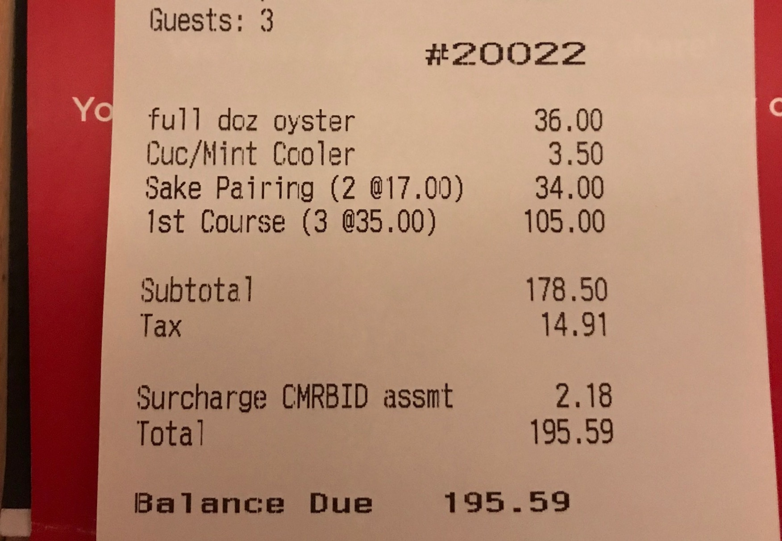
Receipt Example
TBID Tax will be noted on customer receipts, similar to this version from Mammoth.

Slide 7
why support tbid
TBID allows for local businesses to control funds raised, not County
TBID creates financially independent organization with strong, independent voice, strengthens Association’s position in negotiations with Placer County
Frees $3.9m of TOT for additional funding of transportation and housing
Funding raised from all sectors that benefit, creating greater equity
Will allow North Tahoe region to more effectively compete with competitive set
Strengthens business support and community enhancements
Notes:
We have held meetings with many of our key business leaders and this is what we have heard –
They agree in concept with an independent source of funding, overseen by the contributors
If they assess themselves to free up funds, they want those funds to address our most pressing needs – housing/transportation
They agree in concept that all benefitting from NLTRA’s services should participate in raising the funding – not just lodging
They agree with supporting the renewal of the existing TOT 2% in 2020 and eliminating the sunset clause – wouldn’t need renewals

Slide 8
PRELIMINARY COMMITMENTS FROM SUPERVISORS
If TBID formed Board would enter into 5 year contract committing the $3.9 M currently funding NLTRA to be utilized for WFH & Transportation initiatives
Contract would also stipulate that a committee, with the members selected by NLTRA board would be the entity which makes recommendations to Board for uses of $3.9 M
The initial term of a TBID is 5 years. If TBID is not renewed Board would agree to fund NLTRA using TOT dollars at current levels plus CPI adjustment
If TBID is formed Board will not support a TOT increase for period of 5 years. Incorporated into the TBID bylaws will be provision that if TOT is increased during 5 year term of TBID then assessment on lodging would be terminated

Slide 9
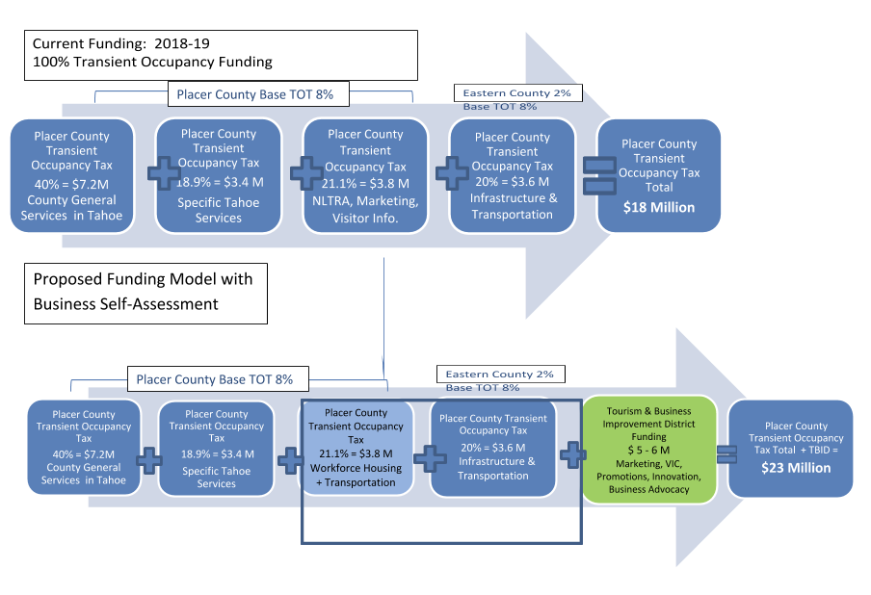
tbid increases revenue for tourism master plan priorities
Notes:
We are willing to assess ourselves to supplement available funding, increasing funding from the current $18 million to something closer to $23 or $24 million
Freeing up $3.8 million – AS LONG AS 100% IS DEDICATED TO TOURISM MASTER PLAN PRIORITIES

Slide 10
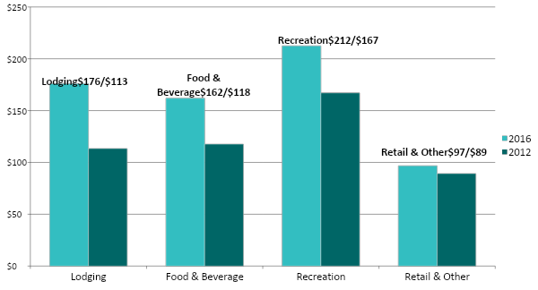
nlt spending by type
($ Million)
Notes:
The economic impact of tourism in North Lake Tahoe is over $650 million annually.
This chart indicates the categories of spending from the analysis completed in 2012 and again in 2016
Recreation spending ranking highest with lodging and food and beverage close behind
Visitor spending on retail is less than other catagories but is still close to $100 million annually in our economy
Our efforts at a TBID we hope to diversify away from relying only on lodging but to raise funds from each of these categories, providing more equity and fairness

Slide 11
preliminary assessment structure for tbid
Assessment on Lodging (1-2%) $2.5 M - $3.0 M
Assessment on F&B, Retail (1%) $2.5M - $2.8M
Assessment on Activities (1%) $600K - $800K*
* Phase 2 will estimate these revenues
DRAFT
Notes:
These numbers are very preliminary and will be part of our intensive work with the businesses on their willingness to assess themselves and the type of services we provide.

Slide 12
BASIS FOR ASSESSMENT STRUCTURE
TBID assessment for lodging at Squaw/Alpine and Northstar be 1% - these areas have existing assessments that provide additional services
In other areas of the TBID the assessment on lodging will be 2%
To be equitable, the additional 1% assessment on lodging at North Lake and Donner Summit will be dedicated to provide specific services for these areas. This will be accomplished by establishing Zones of Benefit
892 businesses which pay sales tax which will be included in district
4,949 businesses which pay TOT which will be included in district

Slide 13
DRAFT TBID BUDGET - ASSESSMENT STRUCTURE: 1% ON LODGING FOR SQUAW/ALPINE & NORTHSTAR ZONES, 2% ON REMAINING LODGING, 1% ON F&B, RETAIL, AND RECREATION
BUDGET CATEGORY | PERCENTAGE OF BUDGET | ALLOCTED DOLLARS
MARKETING, PROMOTIONS, & SPECIAL EVENTS | 53.0% | $3,050,000
VISITOR INFORMATION CENTERS | 7.8% | $450,000
CHAMBER OF COMMERCE: SUPPORT & ADVOCACY FOR BUSINESSES & BUSINESS ASSOCIATIONS | 7.0% | $400,000
ECONOMIC DEVELOPMENT, INCLUDING WFH & TRANSPORTATION & OTHER OPPORTUNITIES | 13.3% | $750,000
OFF SETTING OF TOURIST IMPACTS | 3.4% | $195,000
ZONE OF BENEFIT FOR NORTH LAKE TAHOE | 13.4% | $776,800
ZONE OF BENEFIT FOR DONNER SUMMIT | 0 .005% | $28,200
COUNTY FEE | 2.0% | $116,000
TOTAL | 100% | $5,766,000

Slide 14
projected timeline – north lake tahoe tbid
April Kick-off of District Formation
May - August Owner Outreach and Education
August Develop draft Management District Plan (MDP)
September Final MDP, Petition Resolutions by Placer County
Sept - October Petition Drive (The Vote)
October Resolution of Intention Placer County
October Notice of Public Meeting/Hearing
November Board of Supervisors – Public Meeting
December Board of Supervisors – Public Hearing
January District Formed
January 2020 District begins collecting assessment
Notes:
Our Board and you approved a contract with Civitas last fall to do the initial work on the potential of a TBID for our region,
After reviewing those results we, with your support, approved a second phase to move forward to the formation of a TBID
While it requires quite a bit of education with our business owners, we are confident that our business community will support the effort.
We look forward to working with you and your staff to raise additional funding to address our Tourism Master Plan priorities.

Slide 15
ESTIMATED SHARE OF TBID VOTE (VOTE IS WEIGHTED)
North Shore lodging (2% assessment) – 27%
Vail Resorts (Northstar), including lodging – 14%
Squaw/Alpine, including lodging – 13%
Resort at Squaw Creek – 6%
Ritz Carlton – 5%
Other Northstar region lodging – 6%
Other Squaw/Alpine region lodging – 3%
Food & Beverage – 10%
Retail – 9%
Other Recreation – 6%
Other Lodging – 1%

Slide 16
TBID – NEXT STEPS
Continue to update 35 largest revenue generators
Complete informational mailing to all businesses to be included in district
Schedule and promote open meetings for business community
Working with Civitas and Exec Committee complete Management District Plan
Petition Drive (September/October) – Secure more than 51% of vote
October through January – Complete County approval process

Slide 17
THANK YOU

Slide 19
history of placer county tot for promotions
Since inception of Transient Occupancy Tax in 1964 (tax in on lodging only), Placer County has invested proceeds in a combination of services and promotions
Originally TOT funded Chamber of Commerce and Visitors & Convention Bureau for promotions & business development
1995 additional 2% increase (total of 10%) in Eastern Placer County for infrastructure and transportation
North Lake Tahoe Resort Association (VCB) funded by TOT thru contract with Placer County
Notes:
This is brief historical perspective as background - we are very appreciative that for over 55 years, Placer County has devoted part of the revenues collected from Transient Occupancy Tax for marketing, promotions, visitor information and business development. Since 1995 you have been contracting with us to provide services and input to you.

Slide 20
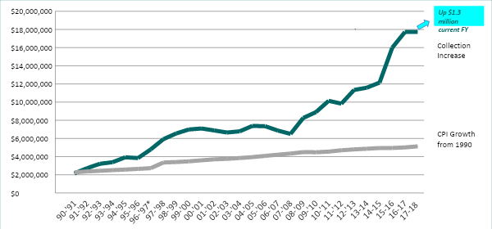
eastern placer transient occupancy tax
Notes:
The primary benefactor in the dramatic increase of TOT revenues has been Placer County, NLTRA’s budget has been significantly increased in past 4 years. NLTRA and its members will be the beneficiary of increases in TBID revenues.
As you know, TOT revenues have been increasing at a higher rate than CPI growth
And unless there is a major catastrophe – revenues will set another record - topping $19 million
While we can’t take full credit for the increased revenues, the efforts you fund through us are certainly part of these results

Slide 21
nltra tourism development priorities
Increasing destination visitation
Increasing occupancy mid-week (extended stays)
Increase non-peak and shoulder seasons
Market emphasis – Reno non-stop flight markets
New York, Los Angeles, San Diego, Chicago, Houston
Shoulder Season - closer destinations, drive markets
Day visitors represent 42% of visits to North Lake tahoe but only generate 11% of spend
Notes:
We focus the funding on our strategic efforts of strengthening our economy by: increasing destination visitation, those that come from further away, stay longer and book further in advance
Our market emphasis is in areas served with direct flights into Reno
This fluctuates depending upon air service changes – for example last year we were in the Austin, TX market
But based on the flight being cancelled (despite its passenger counts)
Looking forward to this next year, we are working with our partners in Reno, and entering the Houston market with new direct flight service by United Airlines
During the shoulder seasons, fall and spring, when the weather and activities are less dependable we focus on drive markets to fill occupancy

Slide 22
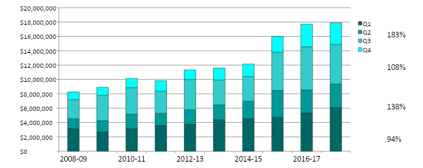
tot growth in shoulder season exceeds growth in peak seasons
Q4
Q3
Q2
Q1
Notes:
In particular – we focus on shoulder seasons efforts – Quarters 2 & 4
In evaluating the ten year growth you can see that Quarters 2 & 4 TOT collections have had more significant growth rates than our peak seasons

Slide 23
eastern placer transient occupancy tax
Notes:
The primary benefactor in the dramatic increase of TOT revenues has been Placer County, NLTRA’s budget has been significantly increased in past 4 years. NLTRA and its members will be the beneficiary of increases in TBID revenues.
As you know, TOT revenues have been increasing at a higher rate than CPI growth
And unless there is a major catastrophe – revenues will set another record - topping $19 million
While we can’t take full credit for the increased revenues, the efforts you fund through us are certainly part of these results

Slide 24
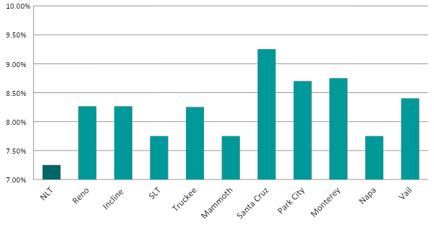
sales tax comparisons
Notes:
Other jurisdictions surrounding our location, as well as in competitive resort areas, have higher sales tax
Distributing an assessment to food and beverage, retail and recreation would still keep us competitive with other destinations

Slide 25
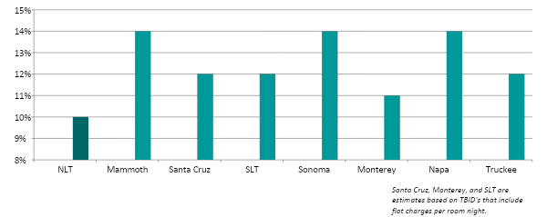
transient occupancy tax comparisons
Notes:
Other resort areas have higher TOT rates
So we will be competitive from a price comparison

Slide 26
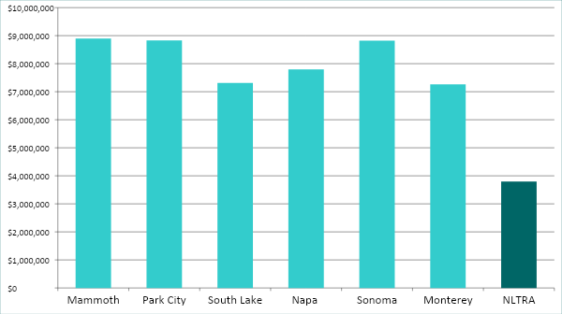
competitive destinations: 2018-19 marketing budgets
Notes:
We do all this with a budget that is much smaller than that of our competitors.
Primarily because many have already supplemented their budgets with self assessments.

Slide 27
nltra priorities set in 2018/19
NLTRA Board supports raising new funding for:
Workforce housing and transportation
Additional dollars for marketing, promotions, events, business development
Community supports raising new funding
71% voters believe region needs additional funding
Strongest voter support to increase TOT, also support sales tax increase
NLTRA Board supports the formation of a TBID to expand business participation and create more equity in contributions
Notes:
We worked with your staff last year to undertake a voter survey and found that
71% voters believed the region needs additional funding
Voters strongly support TOT increases (of course - they don’t pay)
But there was also significant support for sales tax increase
NLTRA Board believes that a TBID is an approach that effectively does both through a voluntary self-assessment by the businesses

Slide 28
bylaws expand board of directors
NLTRA Board Revised to expand representation and pursue independent funding
6 Designated Directors – largest economic generators
5 Elected Directors –
1 Lodging/Property Mgmt. East of Dollar Hill (in Tahoe Basin)
1 Lodging/Property Mgmt. West of Dollar Hill (in Tahoe Basin)
3 At Large (any business member within region)
1-5 Appointed Directors – “preference for attaining maximum geographic and business type and size diversity” appointed by the above 11 Directors
1 At-Large Director - appointed by Placer County Board of Supervisors

Slide 29
Rob Kautz
Co-CEO, North Lake Tahoe Resort Association
Email: Rob@GoTahoeNorth.com
Phone: 530-913-7101
Liz Bowling
Director of Communications, Public Relations & Business Advocacy
Email: Liz@GoTahoeNorth.com
Phone: 530-581-8778

Slide 78
Options for Discussion
If Business Associations want to participate – what is the appropriate budget?
Replace County funding, replace membership funding, allow for growth
Structural options:
Contract with NLTRA?
Combine some of the services and programs?
Shared Staff/Resources?
Priorities?
Notes:
Our Board and you approved a contract with Civitas last fall to do the initial work on the potential of a TBID for our region,
After reviewing those results we, with your support, approved a second phase to move forward to the formation of a TBID
While it requires quite a bit of education with our business owners, we are confident that our business community will support the effort.
We look forward to working with you and your staff to raise additional funding to address our Tourism Master Plan priorities.

Slide 110
Thanks for Your Support

