Slide 1
EASTERN placer COUNTY NEXUS-BASED AFFORDABLE/Workforce HOUSING FEE
North Lake Tahoe Resort Association
August 7, 2019

Slide 2
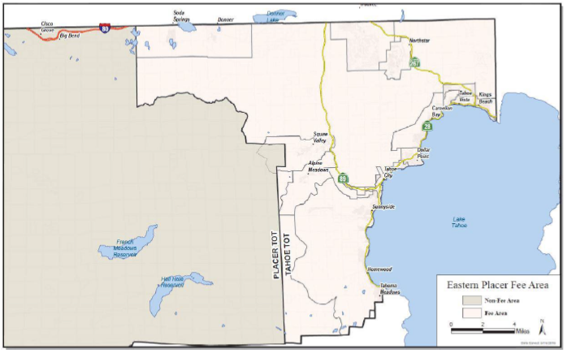
Purpose of the Study
To consider establishing an Eastern Placer County Affordable/Workforce Housing Fee for:
New Market-Rate Residential Development, and
New Commercial Development
By demonstrating nexus between new development and the increase in demand for workforce housing

Slide 3
Background
In 2015, Placer County contracted with Hansford Economic Consulting and Mintier Harnish Planning Consultants to provide a nexus-based Workforce Housing Fee Study
The Study determined the maximum justifiable fee that could be adopted as impact or in-lieu fee.
August 8, 2017, as part of the Annual Housing Program Work Plan agenda item, Board received a presentation from Hansford Economic Consulting on the Eastern Workforce Housing Fee Study.
January 26, 2018, the nexus-based eastern Workforce Housing Fee Study was updated to reflect more current cost information.
October 23, 2018, an item went to the Board discussing establishing the Eastern Placer County Affordable/Workforce Housing Fee

Slide 4
Current Requirement
New Development: Required to provide workforce housing equal to at least 50 percent of the housing demand generated by the project. Required workforce housing is to be provided in one of four ways:
Construction of on-site employee housing;
Construction of off-site employee housing;
Dedication of land for needed units; and/or
Payment of an in-lieu fee.
Expansion of Existing Development: Requirement only applies to the portion of the project that is expanded OR an intensification of use.

Slide 5
What is the Basis of the Fee
Development in eastern Placer County of new residential and non residential land uses will generate additional need for workforce housing.
The fee is mitigation for the impact of increased demand for workforce housing.
Calculated on the number of income-qualified worker households generated by new development and the financing gap / subsidy amount necessary to house those low to moderate income households.
The study uses the affordability gap methodology, which is an industry-established methodology, to calculate “maximum justifiable fees”.

Slide 6
Affordable Housing Fee Options
Option 1: No Fee
Currently there is no established fee for affordable/workforce housing in unincorporated Placer County. If the Board does not wish to move forward with a fee, the County would continue negotiating affordable housing obligations on a case-by-case basis.
Option 2: Adopt a Fee
If the Board wishes to move forward with a fee, the nexus study completed for eastern Placer County provides fee program and level options.

Slide 7
Staff Recommends
No fee option for specific plan or Area Plan or larger General Plan amendment projects. - These projects should be required to construct affordable housing units as the plan areas have sufficient acreage to make it feasible.
Allow a Workforce Housing Fee as an option for projects when an affordable housing obligation equals less than five units (“Smaller Projects”).
Set Affordable Housing Fee at 20% below the maximum justifiable amount for rental residential units or 2.6% of sale price
50% of maximum justifiable for non-residential new development as an option for Smaller Projects only.
$36.50 per campsite
$5,850 per lodging room
$20.50 to $30.50 per building square foot
Except, restaurant/bar uses, which would be set at $92 per square foot (due to low wages in that sector)

Slide 8
Staff Recommended Fee Exemption
Exemption to the policy for Projects that propose a General Plan or Area Plan amendment that achieves one or more of the following:
Amendment to Medium to High Density Residential for the purpose of constructing 8 or more units per acre that result in the development of a mix of housing sizes, types and affordability.
Development of an infill site as defined by Public Resource Code 21061.3.
Development within a “Transit priority area” defined as an area within one-half mile of a major transit stop that is existing or planned.
Conversion of nonresidential buildings to residential use.
Market rate units with a habitable square foot of less than 1,800 sq. ft.

Slide 9
Conclusion and Next Steps
If the Board directs staff to proceed with the adoption of a fee, staff would return with:
Ordinance to regulate when and how the fee would be applied, and
Resolution that approves the Nexus Study for the establishment of the Affordable/Workforce Fee schedule, and sets the initial amount of the fees and an escalator.
For more information please contact: Shawna Purvines at spurvines@placer.ca.gov or 530-745-3031

