Slide 1
TOURISM BUSINESS IMPROVEMENT DISTRICT (TBID) - UPDATE
AUGUST 7, 2019

Slide 2
county tourism master plan recommends additional spending
Tier 1 Priorities – Summary of Additional Funding Needs
 |  | Annual | 8 Year Estimate
 | Visitor Activities & Facilities | $ 7,096,250 | $ 56,770,000
 | Transit | $ 3,100,000 | $ 24,800,000
 | Marketing/Visitor Information | $ 2,200,000 | $ 17,600,000
 | TOTAL Additional Funding Needed | $ 12,396,250 | $ 99,170,000
NLTRA BOARD ALIGNS WITH MASTER PLAN RECOMMENDATIONS
Notes:
Our efforts in marketing, promotions, and visitor services are important
but additionally both NLTRA and Placer County adopted a Tourism Master Plan in 2015 that identified other priorities for funding –
Visitor Activities & Facilities and Transportation
That adopted plan was developed after extensive public outreach and input and identified the need for significant additional funding – projected need of $100 million just for Top Tier Priorities over the 8 years remaining on the current
It also identified the need for additional funding sources including consideration of the formation of a Tourism Business Improvement District

Slide 3
COUNTY TRANSIENT OCCUPANCY TAX - $18 MILLION CURRENT USES:
PLACER COUNTY BASE TOT - 8%
EASTERN COUNTY - 2%
Placer County
TOT
40% = $7.2 M
County General
Services in
Tahoe
Placer County
TOT
18.9% = $3.4 M
Specific Tahoe
Services
Placer County
TOT
21.1% = $3.8 M
NLTRA
Marketing,
Visitor Info
Placer County
TOT
20% = $3.6 M
Infrastructure
&
Transportation
Placer County
TOT Total
$18 million

Slide 4
nltra priorities set in 2018/19
NLTRA Board supports raising new funding for:
Workforce housing and transportation
Additional dollars for marketing, promotions, events, business development
Community supports raising new funding
71% voters believe region needs additional funding
Strongest voter support to increase TOT, also support sales tax increase
NLTRA Board supports the formation of a TBID to expand business participation and create more equity in contributions
Notes:
We worked with your staff last year to undertake a voter survey and found that
71% voters believed the region needs additional funding
Voters strongly support TOT increases (of course - they don’t pay)
But there was also significant support for sales tax increase
NLTRA Board believes that a TBID is an approach that effectively does both through a voluntary self-assessment by the businesses

Slide 5
tourism business improvement districts
109 have been formed throughout California
Formed through Property and Business Improvement District Law of 1994
Businesses assess themselves, designed, created, and governed by those who pay the assessment (requires 50%+1 of the assessment to approve)
Assessment generally passed on to guest/customer of the business
Funds cannot be diverted to general government programs
Notes:
Here is information on TBIDS

Slide 6
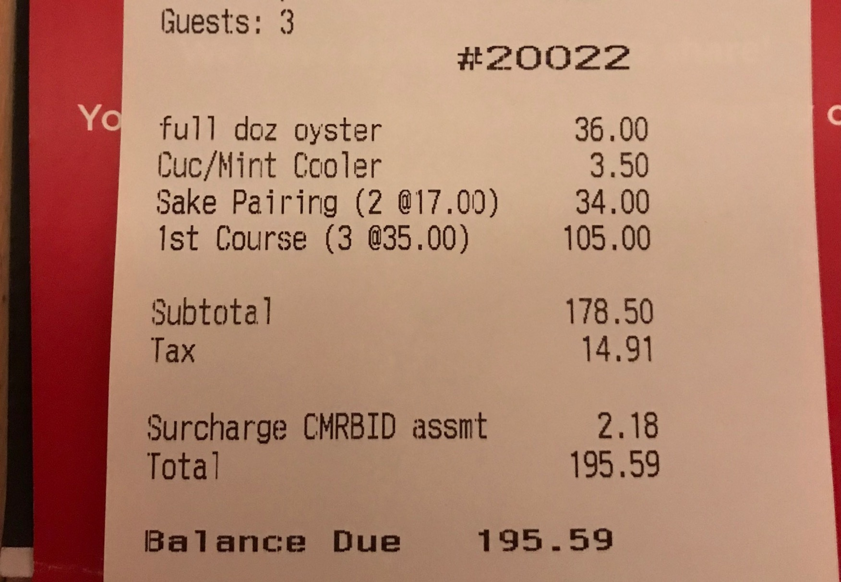
Receipt Example
TBID Tax will be noted on customer receipts, similar to this version from Mammoth.

Slide 7
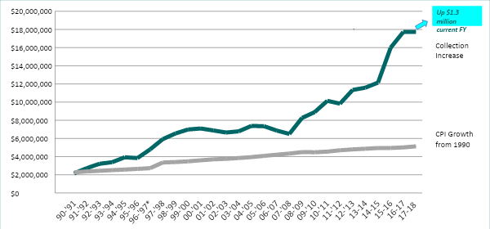
eastern placer transient occupancy tax
Notes:
The primary benefactor in the dramatic increase of TOT revenues has been Placer County, NLTRA’s budget has been significantly increased in past 4 years. NLTRA and its members will be the beneficiary of increases in TBID revenues.
As you know, TOT revenues have been increasing at a higher rate than CPI growth
And unless there is a major catastrophe – revenues will set another record - topping $19 million
While we can’t take full credit for the increased revenues, the efforts you fund through us are certainly part of these results

Slide 8
why support tbid
TBID allows for local businesses to control funds raised, not County
TBID creates financially independent organization with strong, independent voice, strengthens Association’s position in negotiations with Placer County
Frees $3.8m of TOT for additional funding of transportation and housing
Funding raised from all sectors that benefit, creating greater equity
Will allow North Tahoe region to more effectively compete with competitive set
Strengthens business support and community enhancements
Notes:
We have held meetings with many of our key business leaders and this is what we have heard –
They agree in concept with an independent source of funding, overseen by the contributors
If they assess themselves to free up funds, they want those funds to address our most pressing needs – housing/transportation
They agree in concept that all benefitting from NLTRA’s services should participate in raising the funding – not just lodging
They agree with supporting the renewal of the existing TOT 2% in 2020 and eliminating the sunset clause – wouldn’t need renewals

Slide 9
PRELIMINARY COMMITMENTS FROM SUPERVISORS
If TBID formed Board would enter into 5 year contract committing the $3.9 M currently funding NLTRA to be utilized for WFH & Transportation initiatives
Contract would also stipulate that a committee, with the members selected by NLTRA board, would be the entity which makes recommendations to Board for uses of $3.9 M
The initial term of a TBID is 5 years. If TBID is not renewed Board would agree to fund NLTRA using TOT dollars at current levels plus CPI adjustment
If TBID is formed Board will not support a TOT increase for period of 5 years. If TOT is increased during 5 year term the TBID assessment on lodging will be terminated

Slide 10
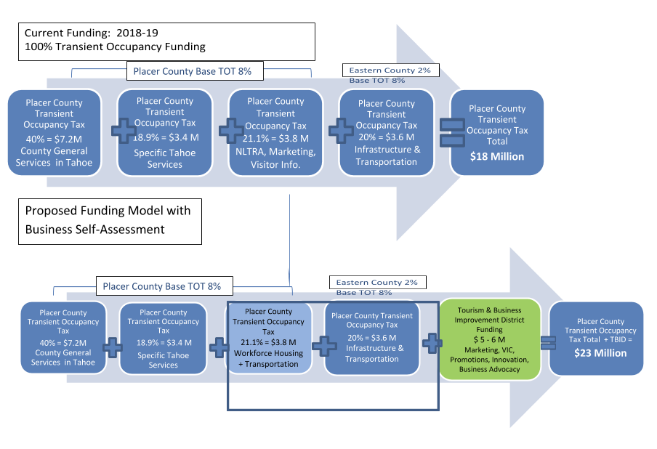
tbid increases revenue for tourism master plan priorities
Notes:
We are willing to assess ourselves to supplement available funding, increasing funding from the current $18 million to something closer to $23 or $24 million
Freeing up $3.8 million – AS LONG AS 100% IS DEDICATED TO TOURISM MASTER PLAN PRIORITIES

Slide 11
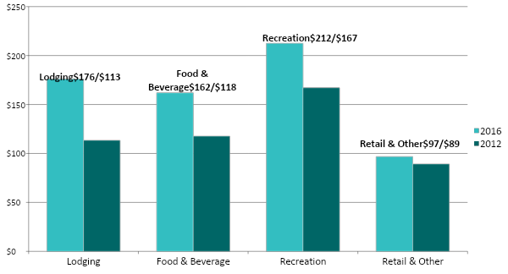
nlt spending by type
($ Million)
Notes:
The economic impact of tourism in North Lake Tahoe is over $650 million annually.
This chart indicates the categories of spending from the analysis completed in 2012 and again in 2016
Recreation spending ranking highest with lodging and food and beverage close behind
Visitor spending on retail is less than other catagories but is still close to $100 million annually in our economy
Our efforts at a TBID we hope to diversify away from relying only on lodging but to raise funds from each of these categories, providing more equity and fairness

Slide 12
BASIS FOR ASSESSMENT STRUCTURE
TBID assessment for lodging at Squaw/Alpine and Northstar be 1% - these areas have existing assessments that provide additional services
In other areas of the TBID the assessment on lodging will be 2%
To be equitable, the additional 1% assessment on lodging at North Lake and Donner Summit will be dedicated to provide specific services for these areas. This will be accomplished by establishing Zones of Benefit
892 businesses which pay sales tax which will be included in district
4,949 businesses which pay TOT which will be included in district

Slide 13
preliminary assessment structure for tbid
Assessment on Lodging (1-2%) $2.5 M - $3.0 M
Assessment on F&B, Retail (1%) $2.5M - $2.8M
Assessment on Activities (1%) $600K - $800K*
* Phase 2 will estimate these revenues
DRAFT
Notes:
These numbers are very preliminary and will be part of our intensive work with the businesses on their willingness to assess themselves and the type of services we provide.

Slide 14
DRAFT TBID BUDGET - ASSESSMENT STRUCTURE: 1% ON LODGING FOR SQUAW/ALPINE & NORTHSTAR ZONES, 2% ON REMAINING LODGING, 1% ON F&B, RETAIL, AND RECREATION
BUDGET CATEGORY | PERCENTAGE OF BUDGET | ALLOCATED DOLLARS
MARKETING, PROMOTIONS, & SPECIAL EVENTS | 53.0% | $3,050,000
VISITOR INFORMATION CENTERS | 7.8% | $450,000
CHAMBER OF COMMERCE: SUPPORT & ADVOCACY FOR BUSINESSES & BUSINESS ASSOCIATIONS | 7.0% | $400,000
ECONOMIC DEVELOPMENT, INCLUDING WFH & TRANSPORTATION & OTHER OPPORTUNITIES | 13.3% | $750,000
OFF SETTING OF TOURIST IMPACTS | 3.4% | $195,000
ZONE OF BENEFIT FOR NORTH LAKE TAHOE | 13.4% | $776,800
ZONE OF BENEFIT FOR DONNER SUMMIT | 0 .005% | $28,200
COUNTY FEE | 2.0% | $116,000
TOTAL | 100% | $5,766,000

Slide 15
projected timeline – north lake tahoe tbid
April Kick-off of District Formation
April – July Owner Outreach and Education
June Develop draft Management District Plan (MDP)
July Final MDP, Petition Resolutions by Placer County
July – September Petition Drive (The Vote)
October Resolution of Intention Placer County
October Notice of Public Meeting/Hearing
November Board of Supervisors – Public Meeting
December Board of Supervisors – Public Hearing
December District Formed
January 1, 2020 District begins collecting assessment
Notes:
Our Board and you approved a contract with Civitas last fall to do the initial work on the potential of a TBID for our region,
After reviewing those results we, with your support, approved a second phase to move forward to the formation of a TBID
While it requires quite a bit of education with our business owners, we are confident that our business community will support the effort.
We look forward to working with you and your staff to raise additional funding to address our Tourism Master Plan priorities.

Slide 16
ESTIMATED SHARE OF TBID VOTE (WEIGHTED VOTE)
North Shore lodging (2% assessment) - 27%
Vail Resorts (Northstar) including lodging - 14%
Squaw/Alpine, including lodging - 13%
Resort at Squaw Creek - 6%
Ritz Carlton - 5%
Other Northstar region lodging - 6%
Other Squaw/Alpine region lodging - 3%
Food & Beverage - 10%
Other Retail - 9%
Other Recreation - 5%
Other lodging - 1%

Slide 17
OUTREACH, EDUCATION & SECURING SUPPORT
Focus on 35 biggest revenue generators - they make up 51+% of vote
4 largest make up 38% of vote (Northstar, Squaw/Alpine, Squaw Creek & Ritz)
Have had one-on-one meetings with 40+ businesses
Response has been very positive, still waiting on decision from Vail and several other businesses (Safeway, Savemart, CVS)
90% of property management companies are supportive
Food & Beverage businesses very supportive (10% of vote)
Retail - Big corporations difficult because of structure

Slide 18
TBID, NEXT STEPS
Continue to follow up as needed with 35 largest revenue generators to secure support
Will schedule ‘town hall’ meetings for businesses by category
Working with Civitas and Exec Committee will draft District Management Plan, then final MDP
Working with Exec Committee and County staff will prepare legal agreement with County
Will prepare letter asking for support from independent short term rental operators
Targeting Petition Drive (The Vote) for end of September/October

