Slide 1
Community Outreach Short Term Rental Ordinance Update January 2022

Slide 2
Vision
Strive for a balance between short term rental opportunities in a diversity of lodging types to both support opportunities for residential lodging and encouraging new or redeveloped lodging in town centers.
Maintain housing supply and attainable housing pricing for workforce.
Achieve host and code compliance to maintain residential neighborhood character by encouraging available and attainable long-term housing in residential neighborhoods and limiting nuisances
Notes:
Stephanie

Slide 3
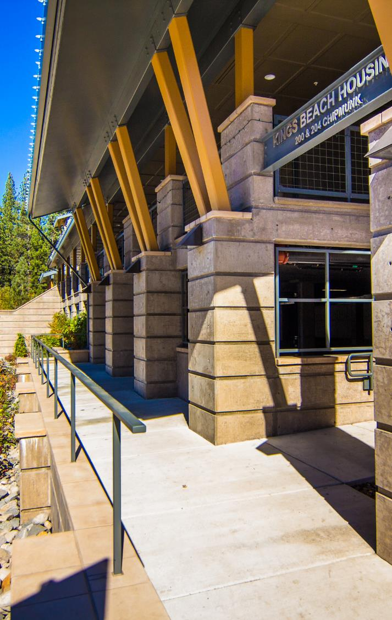
Key Issues
Workforce Housing Viability
Neighborhood Character
Fire & Life Safety
Hotel Economy
Staffing/Enforcement
Notes:
Stephanie

Slide 4
STR/TOT Data & Economic Study
Notes:
Stephanie

Slide 5
Housing Vacancy Trends
Source: 2006-2010 and 2015-2019 American Community Survey (ACS); BAE, 2021.
Notes:
Stephanie

Slide 6
STR Occupancy and Revenue
Sufficient to support debt service equal to >50% of the median priced home (YTD $855k)
Financially competitive compared to long-term rental rates for single-family homes and condos
 | Nights Available | Nights Occupied | Occ. Rate | Average Daily Rate (ADR) | Average Annual Revenue | Average Monthly Revenue
Average | 250 | 103 | 41% | $344 | $35,320 | $2,943
Median | 274 | 88 | 32% | $286 | $25,181 | $2,098
Source: Placer County; BAE, 2021.
Notes:
Stephanie

Slide 7
Literature Review
Consistent findings that:
STRs incentivize the conversion of long-term housing
STR activity correlates to increased housing costs
Move towards increased investor activity
Other notable findings
The impact of STRs on hotels is less well studied
Trending towards a modest impact to hotel revenue
Rapid STR growth makes modest effects significant
Notes:
Stephanie

Slide 8
Economic Study Findings
1. Literature review indicates STR's impact the availability and affordability of long-term housing and hotel feasibility
~28% of current housing stock being active used for STR
Since 2010
43% increase in STR units
47% increase in condotel/timeshares
~0% increase in hotel/motel units
Annual gross revenue avg. $35,000; avg. 103 nights/year
Current avg. gross revenue competitive with revenue that could be generated through long-term renting
Offset a significant portion of the property owners holding costs.
Notes:
Stephanie

Slide 9
Overall Housing & Economic Development Strategies
Workforce Housing Development
Freed up TOT from TBID dedicated to housing & transportation
Workforce Housing Preservation Program
Truckee Tahoe Workforce Housing Agency
Housing Regulatory Updates
North Lake Tahoe Economic Development Incentive Program - TOT rebate for commercial lodging
Upcoming Tahoe Basin Area Plan amendments - economic sustainability of town centers
Workforce
Housing
Hotels/
Motels
Short-Term
Rentals
Notes:
Crystal

Slide 10
Board of Supervisors Workshop December 2021
Notes:
Crystal

Slide 11
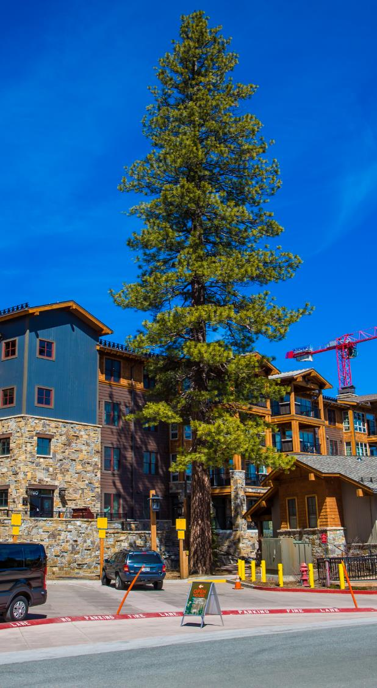
Ordinance Cleanup/Modifications
Modify Exemption Language
Add/increase fire protection standards
Stricter nuisance standards
Increased STR unit postings
Limits one per property
Rolling annual permit
Increased penalty fines
Modified appeal process
Notes:
Crystal

Slide 12
STR Board Feedback
Numerical Cap for STRs
→ Option D
Existing Inventory +
Capacity Expansion
Max/Min # of Nights rented
Remove Ordinance exemptions
Add primary homeownership to the CAP limitation
Stricter penalties for violations
Adaptive management of the program
Notes:
Crystal

Slide 13
Not Subject to Ordinance (NO STR Permit Required)
Hotel/Motel/Timeshare/Bed and Breakfast
Condo Hotels:
Definition: a facility meeting the definition of a hotel or motel, rented to the general public for overnight or other temporary lodging, with ownership structured as a condominium, cooperative or other ownership/financing arrangement, but shall not include timeshares in or interval or fractional ownership of a hotel. The condo-hotel has front desk in-person management with access to all units who responds to complaints, enforces trash, noise, and parking rules, and includes NFPA 13-R or 13 fire sprinkler systems and NFPA 72 centrally monitored fire alarm system connected to all individual units and is inspected annually.
Primary Ownership/Hosted STRs:
Notes:
Step
156 units

Slide 14
Option D Methodology
Existing Inventory Data process:
Baseline: Approved STR permits + STR exemptions
Other STR Activity
TOT Certificates
Hotel/Motel/Timeshare/B&B/Condo Hotel
Homeowner Exemption
STR Permits
STR exemptions
Active TOT from 1/1/2019 (pre-pandemic)
Capacity Increase: 10%
Notes:
Stephanie

Slide 15
Numerical Cap of STRs – Permit Priority
Proposed STR Ordinance Language
Current STR permits for renewal
2. Currently approved exempted properties
3. New Permits (remaining available cap units)
Properties previously renting without an approved STR Permit or exemption
New STR property applications
Notes:
Stephanie

Slide 16
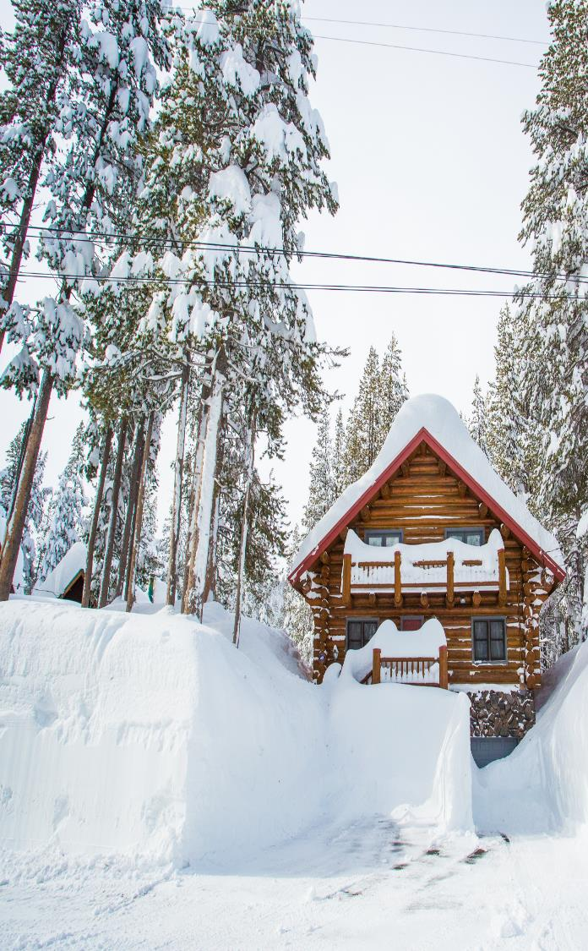
Next Steps
January 6th, 2022 → District 5 Town Hall
January 19th, 2022 → TCDA and NTBA Board Meetings
January 25th, 2022 → Board of Supervisors Action Request
February 8th, 2022 → (If Adopted) Board of Supervisors 2nd Reading
March 2022 → Implementation
Notes:
Stephanie

Slide 17
Questions/Comments
Notes:
End Presentation

