Slide 1
NLT TBID 2022/23 Preliminary Budget Figures

Slide 2
Budgeted / Forecasted Collection of TBID Assessment
MDP assumes approximately $6 million in annual assessments
Given the lack of historical data, collections for FY2022/23 are assumed to follow the MDP
Budgeted Expenditures NLT TBID
Budgeted expenditures total $7 million
Higher than forecasted collections on assessments, lower than budgeted expenditures in FY 2021/22

Slide 3
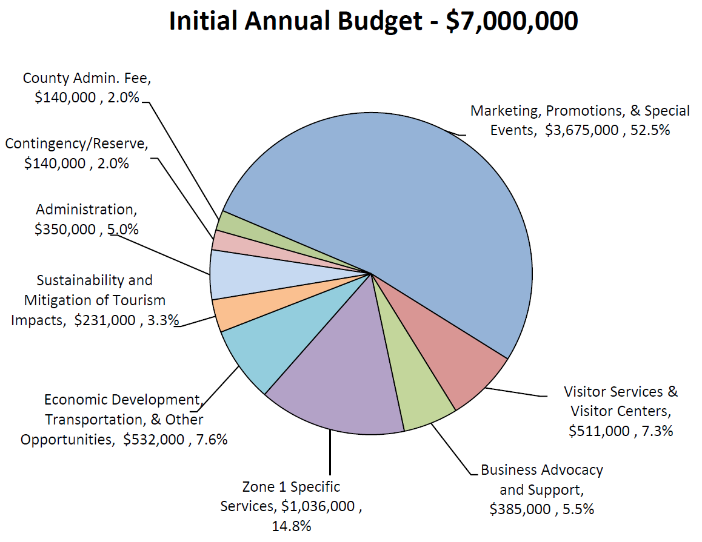
North Lake Tahoe Tourism Business Improvement District
Notes:
To explain how the assessments can be expended, not meant for specific budget discussion here

Slide 4
TBID Budget Summary Fiscal Year 2022/23
TBID Revenue | 6,000,000
TOT Revenue | 122,386
VIC Revenue (net of CGS) | 30,000
Membership Dues & Activities | 95,000
Total Revenue: | 6,247,386
Salaries & Wages | 1,963,608
Rent & Utilities | 193,922
Phone/Internet | 20,820
Supplies & Mail | 37,500
Maintenance, Support, Repairs, Etc. | 59,580
Insurance | 15,000
Taxes, Licenses, Fees | 37,500
Dues, Subscriptions, etc | 16,000
Board Functions | 48,000
Staff expenses | 23,000
Professional Fees | 130,000
Events | 565,000
Coop Contributions | 1,440,000
Non-coop marketing | 197,000
NTBA/TCDA Funding | 200,000
Membership Luncheon | 6,000
Community Awards Dinner | 30,000
Membership Activities | 2,400
eBlasts | 7,200
TMBC | 3,000
Add'l Opportunities | 2,131,000
Total expenditures: | 7,126,530
Net results: | (879,144)
Budget |  | Known expenditures | Available TBID funds
7,000,000 | Total | 4,877,000 | 2,123,000
3,675,000 | Marketing | 3,150,000 | 525,000
511,000 | Visitor Center & Services | 352,000 | 159,000
532,000 | Econcomic Dev, Trans, + | 188,000 | 344,000
231,000 | Sustainability, Mitigation of Tourism Impact | 133,000 | 98,000
385,000 | Business Advocacy & Support | 509,000 | (124,000)
1,036,000 | Zone 1 | 171,000 | 865,000
350,000 | Admin | 350,000 | -
140,000 | County Admin | 20,000 | 120,000
140,000 | Contingency | 4,000 | 136,000
 | 15% allowed adjustment | $1,050,000

Slide 5
TOT & Administrative Overhead Budget Summary Fiscal Year 2022/23
CAP/TOT Senior Specialist – 80% funded from “freed up” TOT
Payroll & related ($97,000)
Overhead/Miscellaneous ($25,000)
Administrative Overhead budgeted expenditures total $972,000
Payroll & Related ($625,000)
Professional Fees (lawyer, accountant, other) ($130,000)
Miscellaneous ($217,000)
$350,000 of total expenditures are offset by the Administration budget category, the remaining $622,000 is allocated among the remaining budget categories based on expenditures.

Slide 6
TBID Assessment Cash Flow
Assessments collected by businesses during the quarter
Assessments submitted to the County in the month following the quarter, and into the following month (some businesses do pay monthly)
NLTRA receives funds the month following receipt by County (1 ½ to 2 months following end of quarter)

Slide 7
Marketing, Promotions, & Special Events
Assessments collected and allocated for FY 2022/23 budgeted at $3,150,000
Budgeted expenditures total $3,675,000
Marketing Coop contributions ($1,440,000)
Payroll & Related ($571,000)
Events ($565,000)
Non-coop Marketing ($172,000)
Overhead/Miscellaneous ($402,000)
Unallocated funds ($525,000)

Slide 8
Visitor Services & Visitor Centers
Retail revenues net of Cost of Goods Sold $30,000
Budgeted Expenditures total $511,000
Payroll & related ($201,000)
Overhead/Miscellaneous ($151,000)
Unallocated funding ($159,000)

Slide 9
Business Advocacy & Support
Membership Revenues of $95,000 from non-TBID member dues and membership activities
Budgeted expenditures total $509,000
Payroll & related ($187,000)
NTBA & TCDA funding ($200,000)
Membership Activities ($54,000)
Overhead/Miscellaneous ($68,000)
Exceeds allocated funding by $29,000, will require either a budget adjustment or use of Contingency/Reserve funds

Slide 10
Zone 1 Specific Services
Funding comprised of additional 1% assessment on lodging businesses within Zone 1 boundary
Budgeted expenditures total $1,036,000
Payroll & related ($61,000)
Overhead/Miscellaneous ($109,000)
Unallocated funding ($865,000)

Slide 11
Economic Development, Transportation, & Other Opportunities
Budgeted expenditures total $532,000
Payroll & related ($122,000)
Overhead/Miscellaneous ($66,000)
Unallocated funding ($344,000)

Slide 12
Sustainability & Mitigation of Tourism Impacts
Expenditures based on reforecast total $231,000
Payroll & related ($98,000)
Overhead/miscellaneous ($35,000)
Additional opportunities ($98,000)

Slide 13
Administration
Budgeted Expenditures total $350,000
Expenditures consist of administrative overhead
Additional admin overhead is allocated among the remaining budget categories based on actual expenditures

Slide 14
County Admin Fee
Budgeted expenditures total $20,000
Allocated funds total $140,000.
Estimated annual costs are much lower than anticipated in the MDP. A budget adjustment will go against this allocation to help offset the higher-than-allocated Business Advocacy & Support expenditures.

Slide 15
Contingency/Reserve
Budgeted funds total $140,000

Slide 16
 | Total | Marketing/Promo/Events | Visitor Services | Business Advocacy | Zone 1 | Econ Dev/Trans/Other | Sustainability | Administration | County Admin Fee | Contingency/Reserve | CAP/TOT Housing & Transportation | Admin
TBID Revenue | 6,000,000 | 3,150,000 | 438,000 | 330,000 | 888,000 | 456,000 | 198,000 | 300,000 | 120,000 | 120,000 | - | -
TOT Revenue | 122,386 | - | - | - | - | - | - | - | - | - | 122,386 | -
VIC Revenue (net of CGS) | 30,000 | - | 30,000 | - | - | - | - | - | - | - | - | -
Membership Dues & Activities | 95,000 | - | - | 95,000 | - | - | - | - | - | - | - | -
TOTAL REVENUE | 6,247,386 | 3,150,000 | 468,000 | 425,000 | 888,000 | 456,000 | 198,000 | 300,000 | 120,000 | 120,000 | 122,386 | -
Salaries & Wages | 1,963,608 | 570,985 | 201,328 | 187,317 | 61,415 | 122,082 | 97,762 | - | - | - | 97,280 | 625,438
Rent/Utilities/Phone/Etc. | 581,322 | 56,280 | 97,822 | 20,231 | 6,953 | 11,075 | 8,339 | - | 20,000 | - | 13,592 | 347,030
Events | 565,000 | 565,000 | - | - | - | - | - | - | - | - | - | -
Coop Contributions | 1,440,000 | 1,440,000 | - | - | - | - | - | - | - | - | - | -
Non-coop marketing | 197,000 | 172,000 | 5,000 | 5,000 | 5,000 | 5,000 | 5,000 | - | - | - | - | -
NTBA/TCDA Funding | 200,000 | - | - | 200,000 | - | - | - | - | - | - | - | -
Membership Activities | 18,600 | - | - | 48,600 | - | - | - | - | - | - | - | -
Add'l Opportunities | 2,131,000 | 525,000 | 159,000 | - | 865,000 | 344,000 | 98,000 | - | - | 140,000 | - | -
TOTAL EXPENDITURES BEFORE OVERHEAD ALLOCATION | 7,096,530 | 3,329,265 | 463,150 | 461,149 | 938,369 | 482,157 | 209,101 | - | 20,000 | 140,000 | 110,872 | 972,468
Admin Overhead Allocation | - | 345,735 | 48,097 | 47,889 | 97,447 | 50,071 | 21,715 | 350,000 | - | - | 11,514 | (972,468)
TOTAL EXPENDITURES | 7,096,530 | 3,675,001 | 511,247 | 509,038 | 1,035,816 | 532,228 | 230,816 | 350,000 | 20,000 | 140,000 | 122,386 | -
NET RESULTS | (849,144) | (525,001) | (43,247) | (84,038) | (147,816) | (76,228) | (32,816) | (50,000) | 100,000 | (20,000) | - | -

Slide 17
Thank you

