Slide 1
2023 World Cup Traffic Management Plan

Slide 2
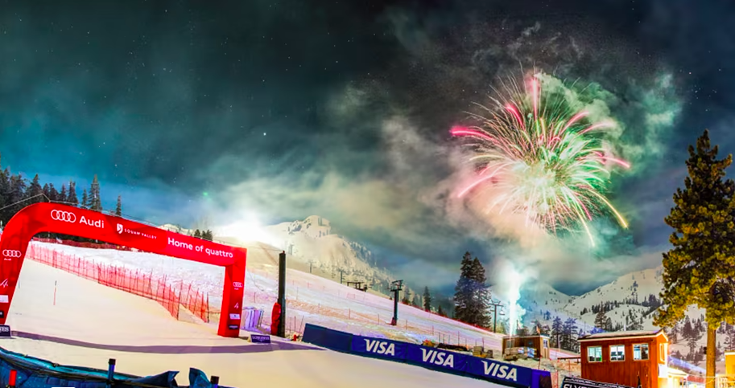
World Cup Traffic Management Plan
Core Strategies
(OVER) Communication and Transparency
Traffic Management
Trip Reduction
Peak Demand Reduction
Employee Incentives

Slide 3
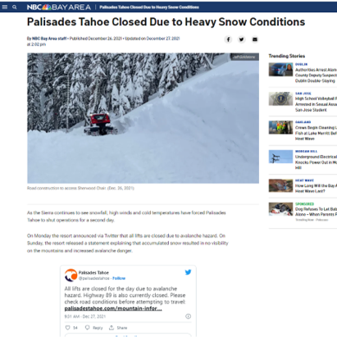
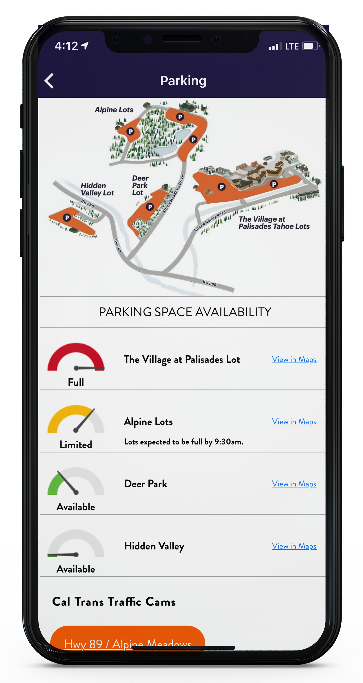
Communications and Transparency
CMS Boards from Truckee to Tahoe City
Social Channels
Radio Spots
App Pushes for Parking Status
Plan ahead messaging to guests
Direct messaging throughout event

Slide 4
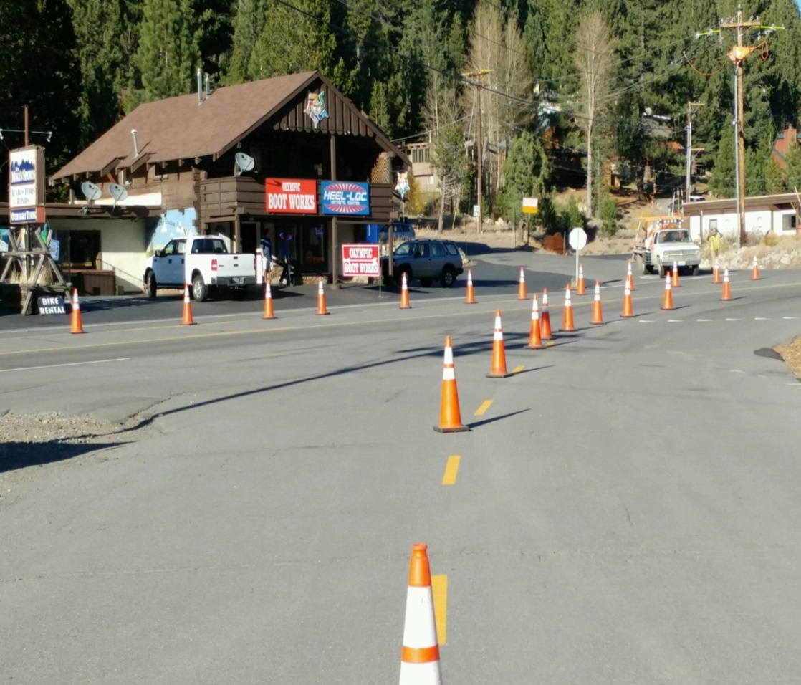
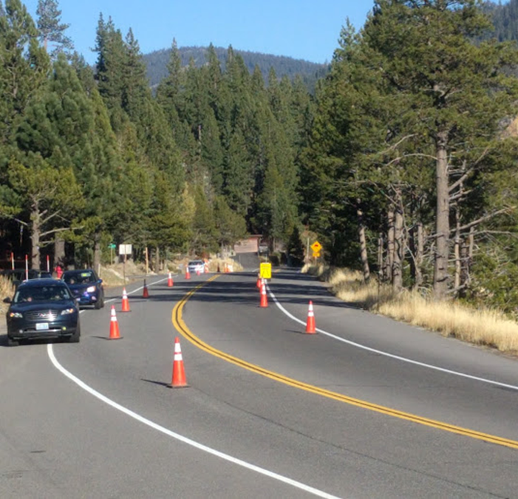
Traffic Management
Supplemental Contract with Nevada Barricade above and beyond normal operations for World Cup weekend
Third Lane
Creates 3 lane traffic pattern on Olympic Valley Rd. for ingress and egress
Merge Patterns
Use extended merges at egress points to traffic flowing in/out of lots
Traffic Light Coordination – CalTrans
Contract with CHP for traffic control assistance
Additional staff to manage and direct from both Palisades and Nevada Barricade arranged for World Cup weekend

Slide 5
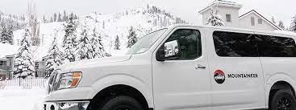
Trip Reduction
Use of various programs to reduce VMT and keep cars off the road for World Cup weekend
Park and Ride lots in Truckee and TC – World Cup Feb 25-26
Mountaineer and TART Connect
Promotional Carpool Parking
Employee Incentives
Supplementing TART headways with add’l contract service
Concentrating room reservations to hotels with shuttles and offering supplemental PT Shuttle Service

Slide 6
Peak Demand Reduction
Disco Tubing in the evenings
Fireworks and Live Concert to delay the egress from normal ski/guest traffic
Food and Drink World Cup specials starting late in the ski day
Expanded hours of operation and Inter-Valley Mountaineer operations
Leverage the Base to Base Gondola – to promote and utilize vehicle parking @Alpine and a ride over to experience the World Cup w/o driving

Slide 7
World Cup PT Employee Incentives
Paid Incentives to employees up to $25 per person per day for use of:
Park and ride locations in TC and Truckee
Carpool 3 or more per vehicle
PT Shuttles from N. Lake and West Shore
Riding TART vs. driving a personal vehicle

